Slide 1
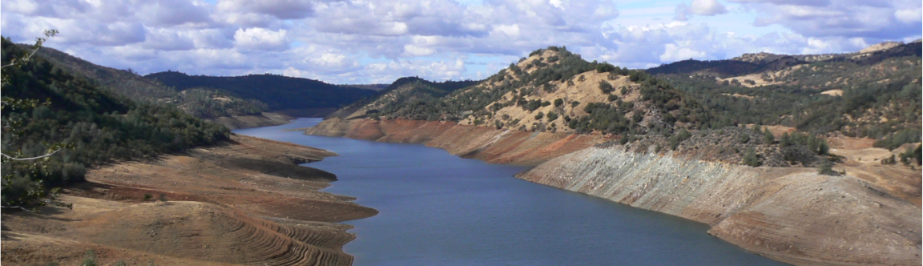
The California drought: how severe is/was it in a hydrological context?
Dennis P. Lettenmaier
Department of Geography
University of California, Los Angeles
Institute of Environment and Sustainability
UCLA
Jan 26, 2015

Slide 2
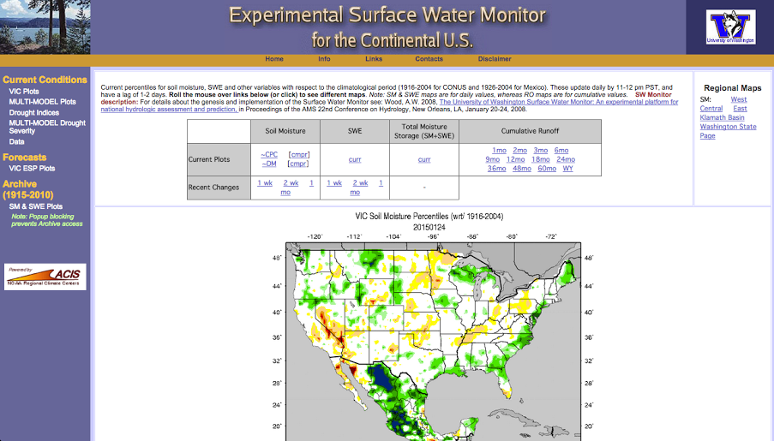

Slide 3
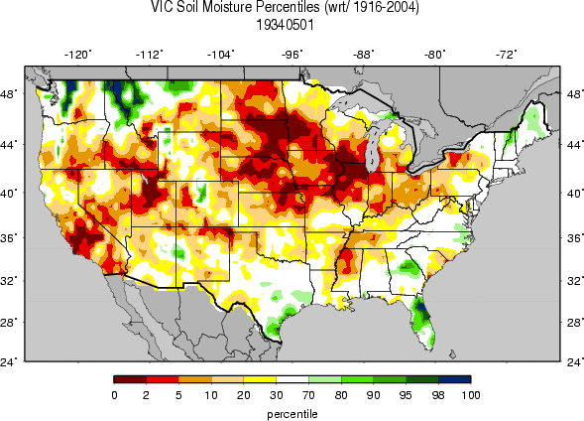
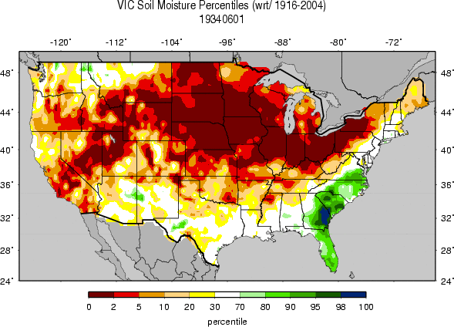
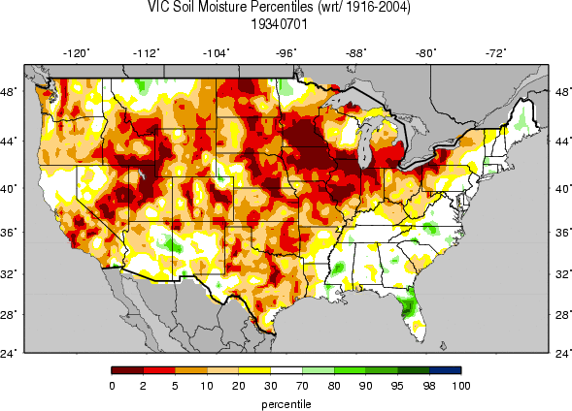
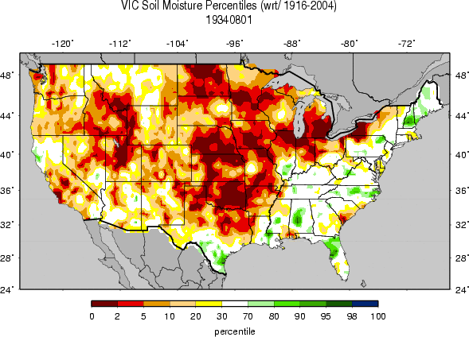

Slide 4
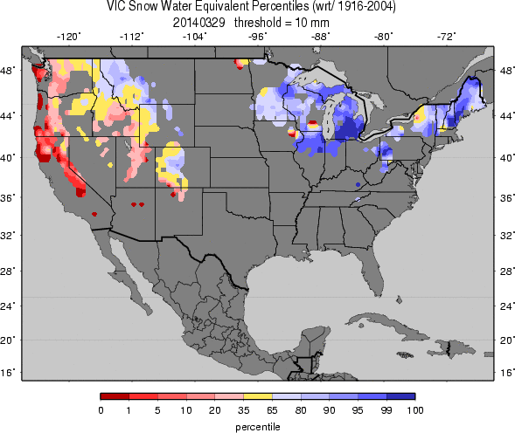
Conterminous U.S. snowpack 3/29/14, as simulated by VIC model (from University of Washington Surface Water Monitor, www.hydro.
washington.edu/
forecast/monitor

Slide 5
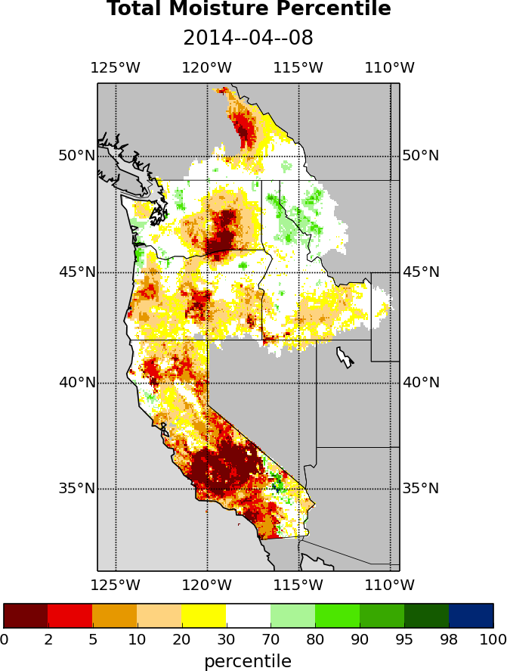
Western U.S. total (soil moisture + SWE) moisture 4/8/14, as simulated by VIC model (from University of Washington Drought Monitoring System for the West Coast)

Slide 6
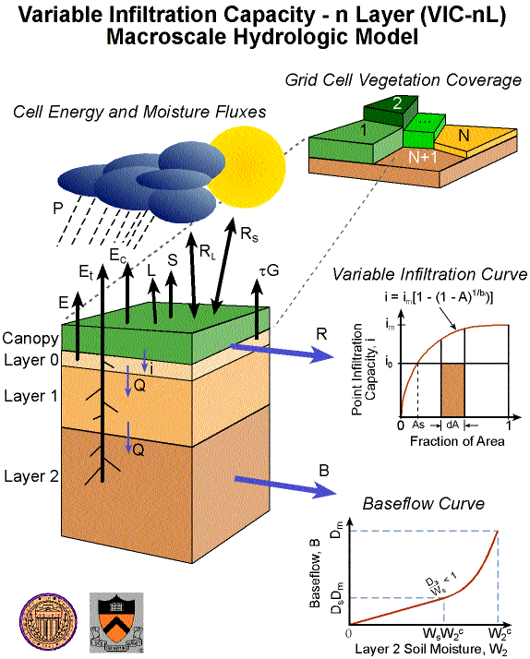
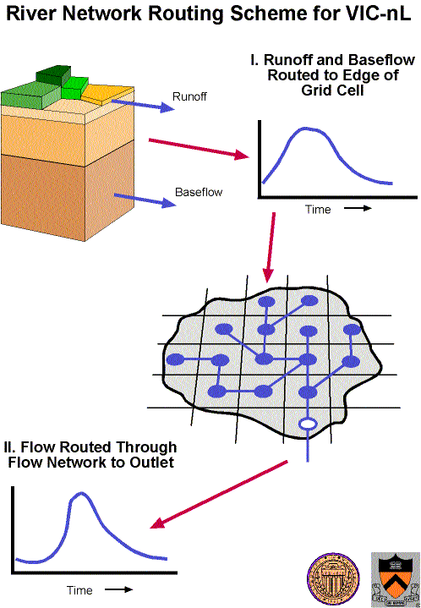
Macroscale hydrology modeling construct

Slide 7
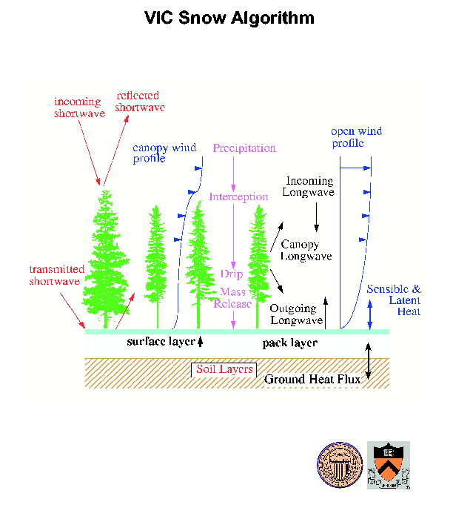

Slide 8
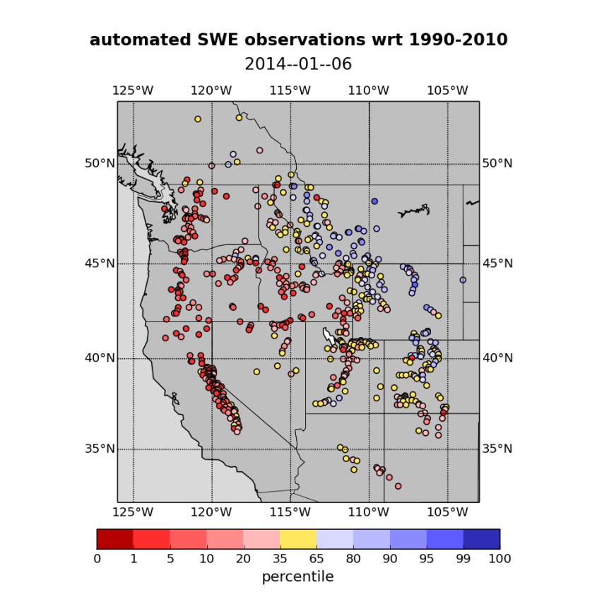
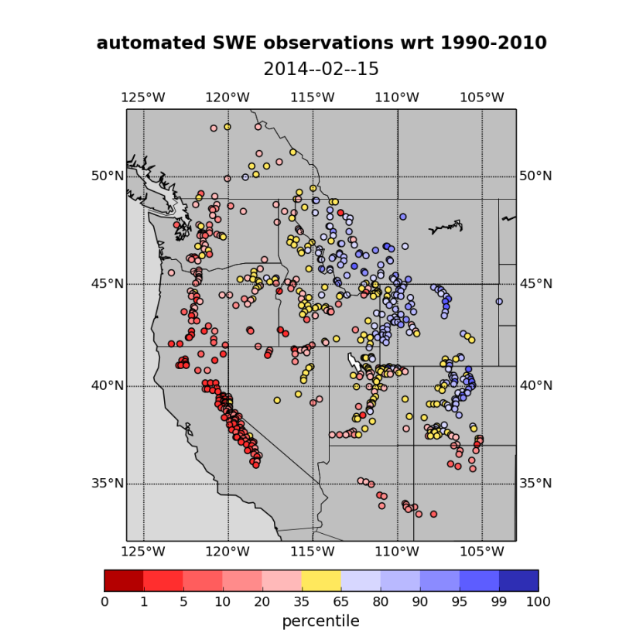
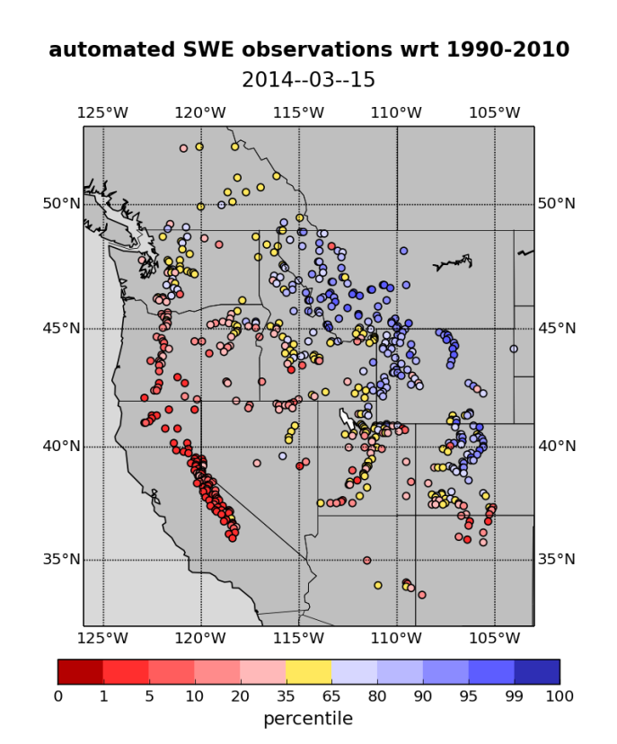
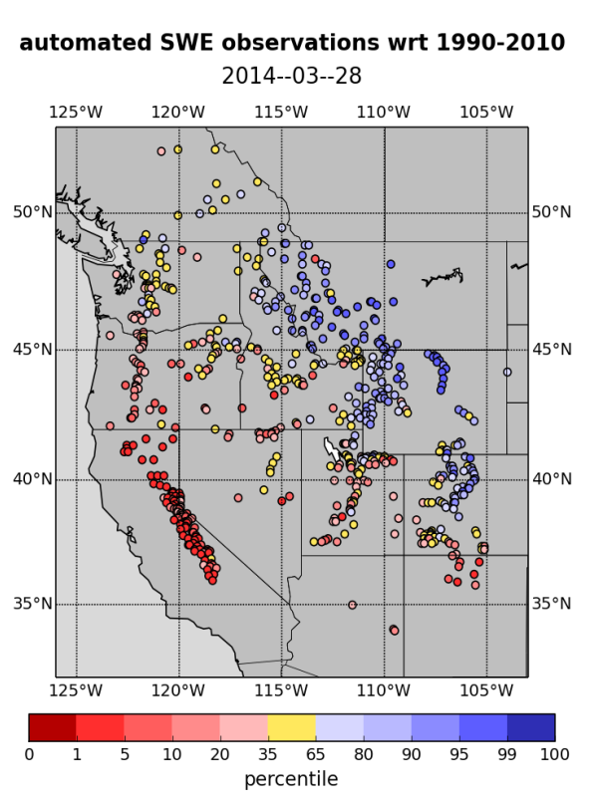

Slide 9
California drought in 2013-2014
Notes:
One sentence

Slide 10
California drought in 2013-2014
Did climate change cause this extreme drought event?
Was it simply a result of natural variability?
VS.

Slide 11
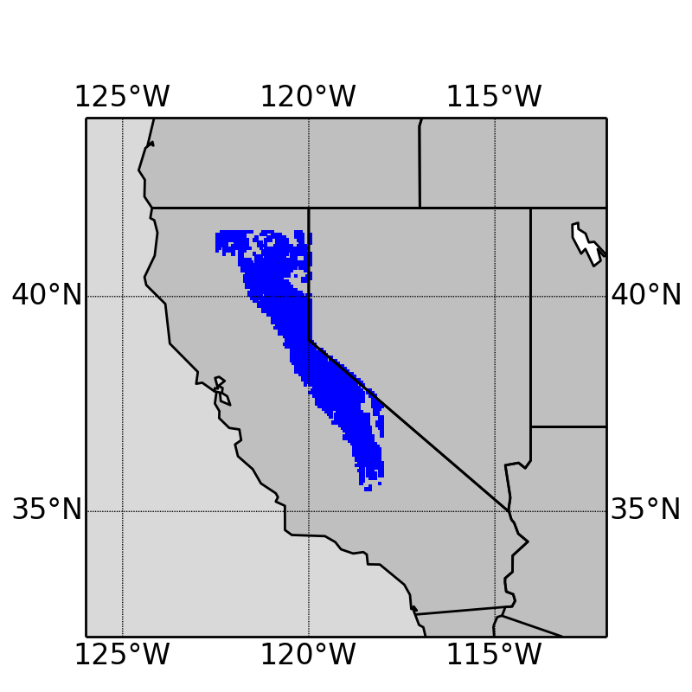
Methodology - Study area and period
Sierra Nevada mountain range
- Long-term Apr 1 SWE > 10 mm
1920-2014
Notes:
All the subsequent analyses are based on this blue area

Slide 12
Methodology - Data
UW Drought Monitor
1/16 degree station-based dataset
(1920-2014)
Daily precipitation (P)
Daily temperature (T)
Snow water equivalent (SWE)
Runoff

Slide 13
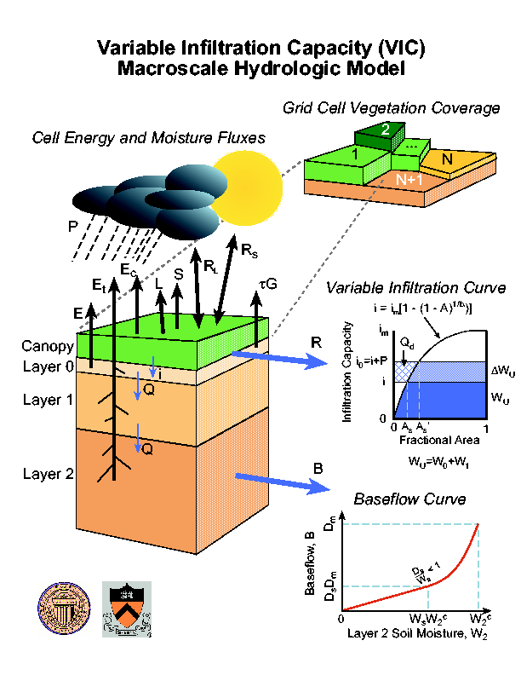
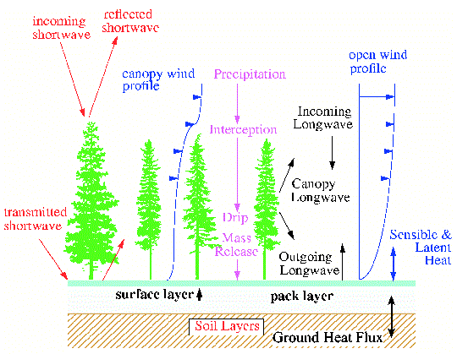
Methodology - Data
UW Drought Monitor
1/16 degree station-based dataset
Daily precipitation (P)
Daily temperature (T)
Snow water equivalent (SWE)
Runoff
VIC model
VIC Snow Algorithm

Slide 14
Analysis and results 1. How has the climate changed in California? (Trend analysis)

Slide 15
1. How has the climate changed in California?
No trend
Increasing trend
+0.4 ºC/100 years
p-value=0.10
Notes:
Precipitation - accumulated, aggregated over the entire study area; no trend
Temperature – increasing trend

Slide 16
1. How has the climate changed in California?
Decreasing trend
-5.0 km³/100years
p-value=0.07
Decreasing trend
-6.2 km³/100years
p-value=0.03
Notes:
SWE – decreasing trend -> let us think that the increasing T trend might be a cause of the decreasing snowpack; further prove it later
Runoff – mostly from snowmelt, so similar dicreasing trend

Slide 17
Analysis and results 2. How dry was California in 2013-2014? (Frequency analysis)

Slide 18
2. How dry was California in 2013-2014?
Winter precipitation
Notes:
Plot winter precipitation in each year on the figure according to plotting position method
Return period – the higher, the less frequent the low-P event would happen, the more severe the drought
2014 is the third lowest; 2014 is very dry, but not the driest; 1977 is the lowest and 1976 also a dry year

Slide 19
2. How dry was California in 2013-2014?
Apr 1 SWE
Notes:
2014 the second driest in terms of SWE; 1977 again the lowest

Slide 20
2. How dry was California in 2013-2014?
Spring runoff
Notes:
Similar

Slide 21
Analysis and results 3. Is there a link between climate change and drought events in California? (correlation analysis & hydrologic simulation)

Slide 22
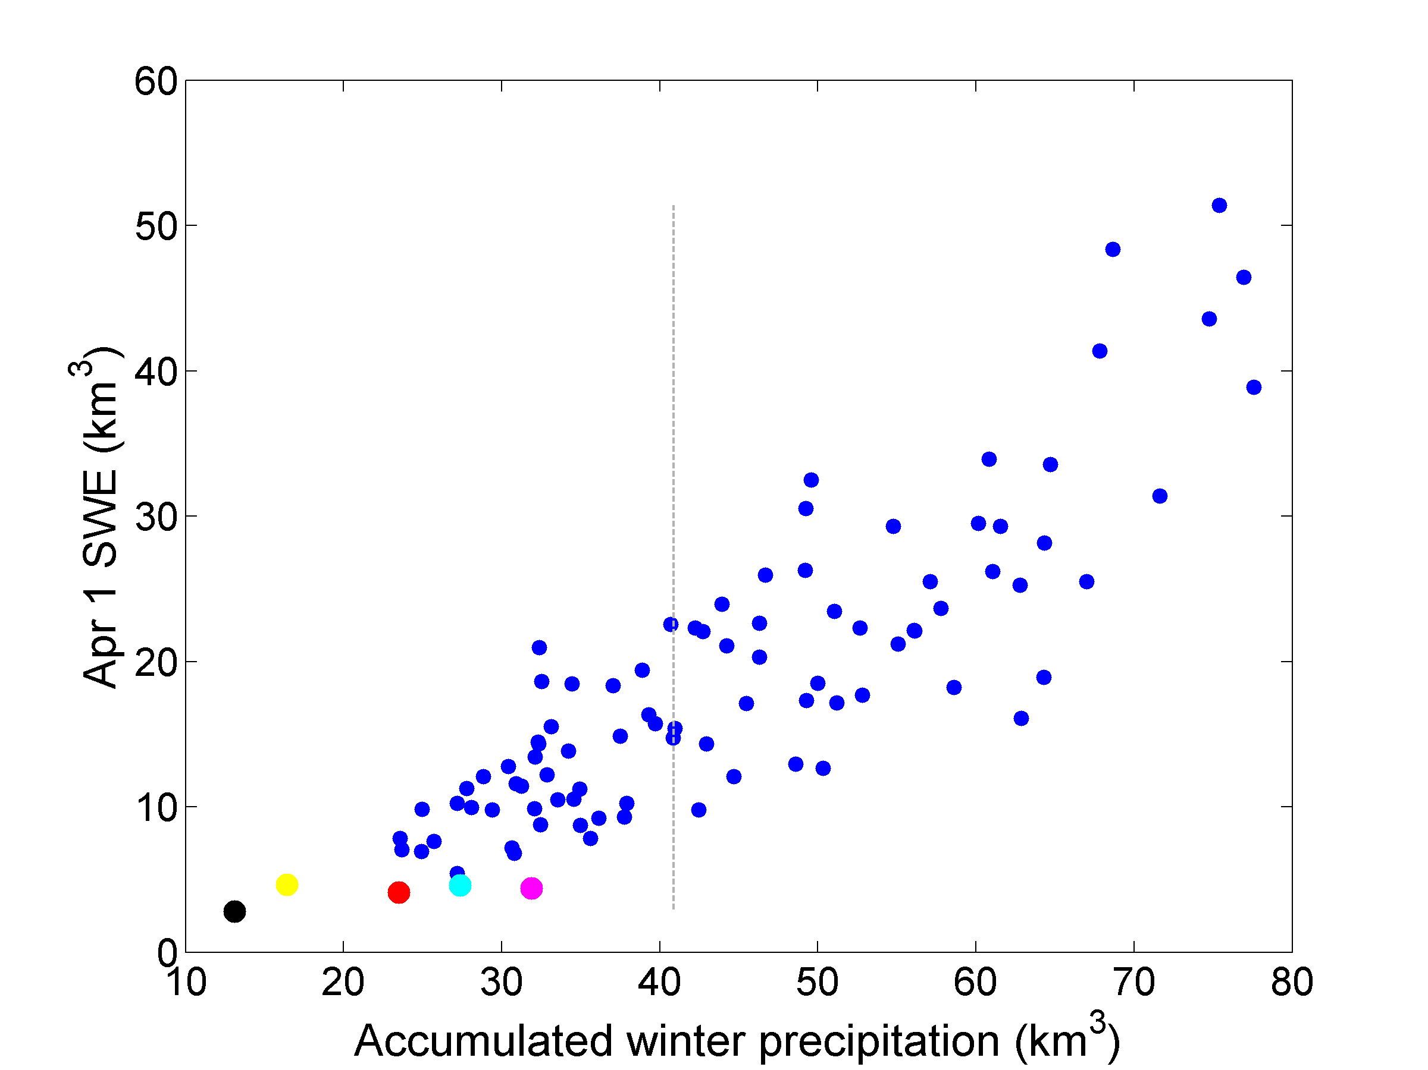
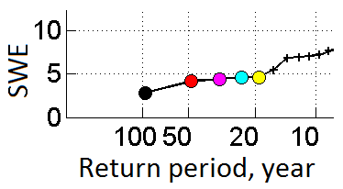
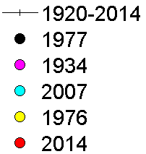
3. Is there a link between climate change and drought events in California?
Method 1 - Correlation analysis
Correlation coefficient: 0.86
median
Notes:
Strong positive correlation
All the five years with the lowest SWE are located at the very low end of winter precipitation

Slide 23
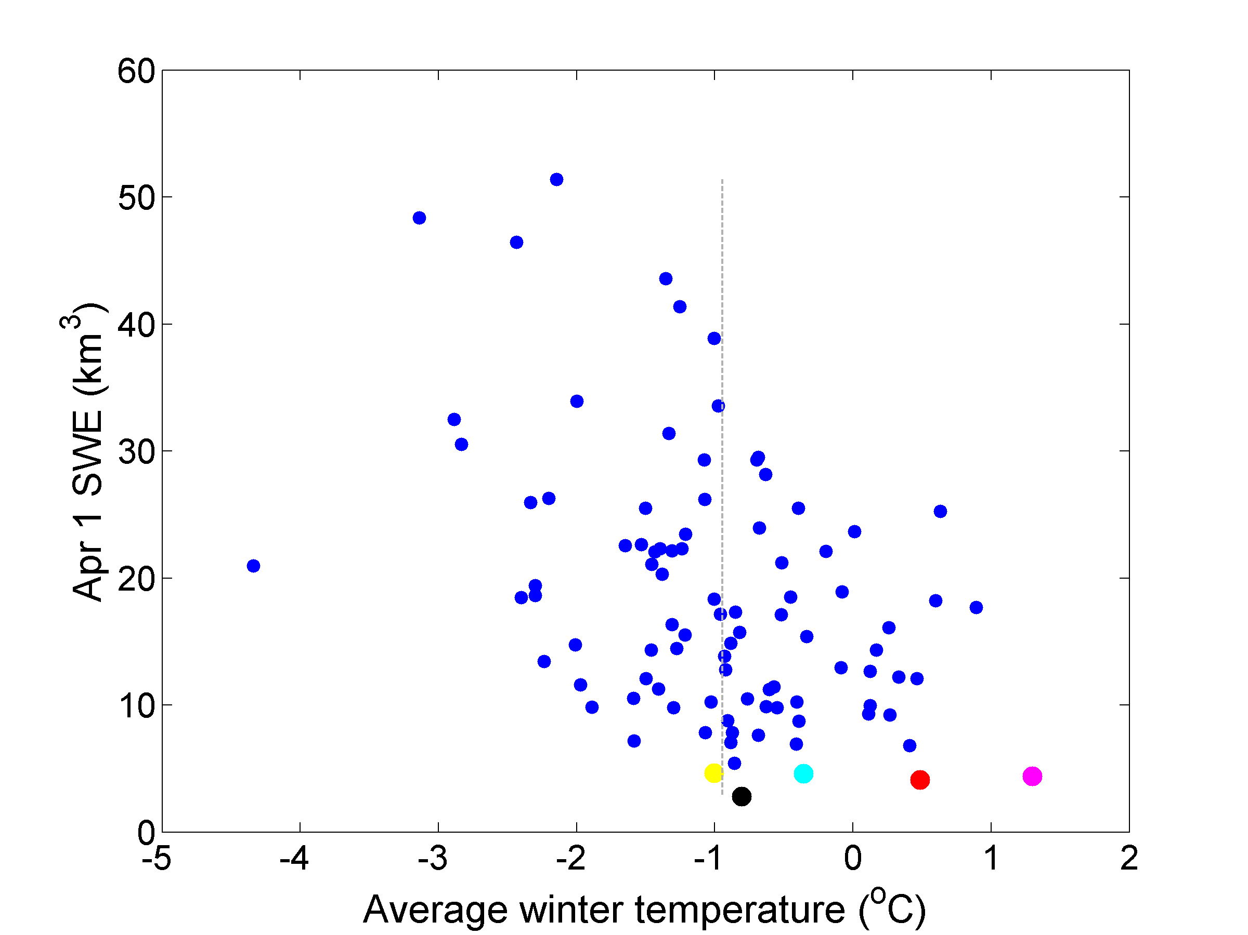
3. Is there a link between climate change and drought events in California?
Method 1 - Correlation analysis
Correlation coefficient: -0.42
median
Notes:
Vague negative correlation -> the warmer the winter, the lower the SWE
Lowest-SWE years generally happened in warmer winters
But 1977 -> around the median of winter temperature, but the lowest SWE; similar to 1976 and 2007

Slide 24
3. Is there a link between climate change and drought events in California?
Method 1 - Correlation analysis
Correlation coefficient: -0.42
median
Apr 1 SWE has much stronger correlation with winter P than with winter T
Notes:
Warmer winter -> might have something to do with lower SWE
But winter P is the main control of SWE
Recall – P does not have trend but lots of variability -> lead us to think that natural variability is the main control on drought

Slide 25
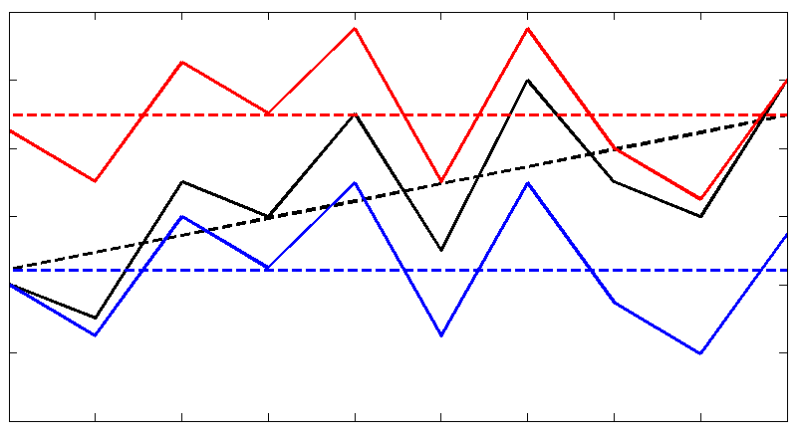
3. Is there a link between climate change and drought events in California?
Method 2 – Detrended-T scenarios
In addition to the reconstructed time series (the ‘base scenario’), we removed the warming trend and simulate hydrological conditions using the VIC model (‘Detrended-T scenarios’, without climate change)
Removing long-term Tmin trend for each grid cell (Tmax does not have significant trend); preserving daily variation
Two detrended-T scenarios:
Warm scenario
Cold scenario
Notes:
Detrended-T scenarios
Introduce the illustration -> detrending in two ways; long-term trend removed and daily variation preserved

Slide 26
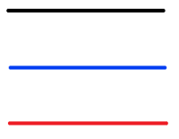
Apr 1 SWE
No trend without warming
Base scenario
Cold scenario
Warm scenario
Notes:
Original decreasing trend disappeared -> strongly suggests that the warming climate is the main cause for the decreasing SWE

Slide 27
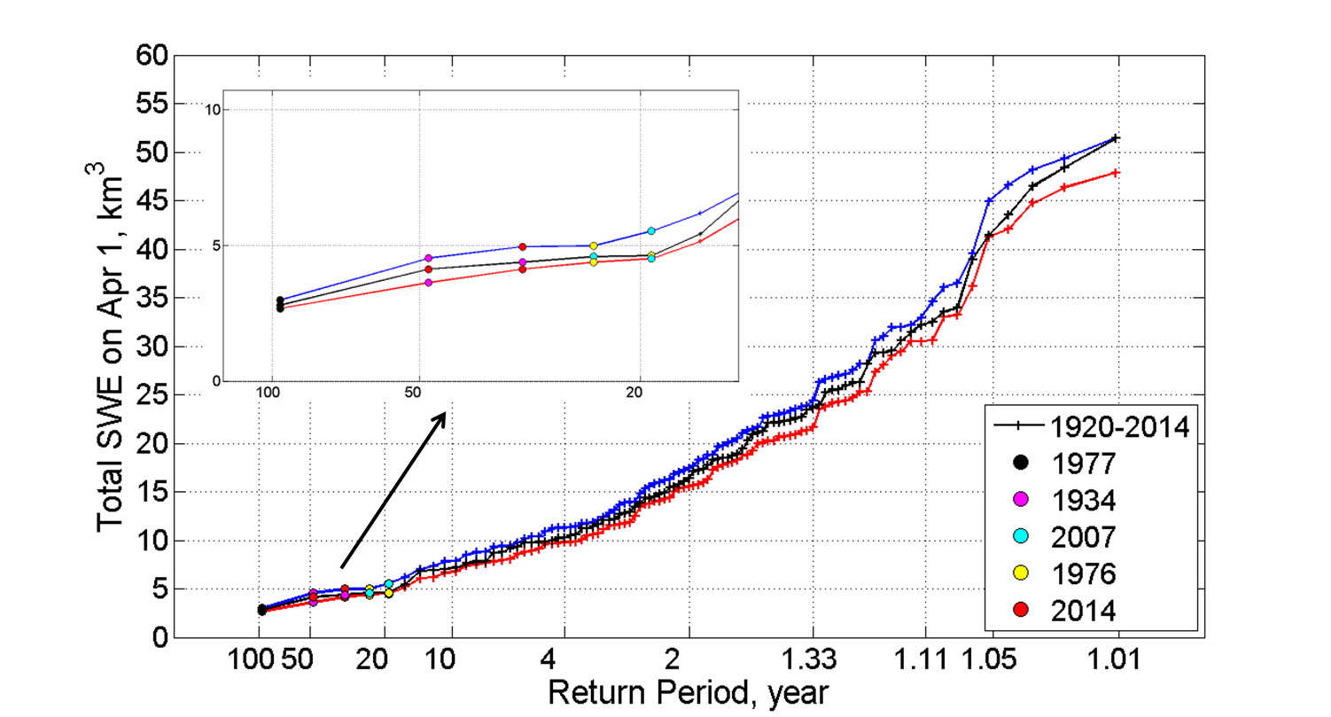
Apr 1 SWE
No trend without warming
Base scenario
Cold scenario
Warm scenario
Notes:
2014 goes up a little bit without climate change, but still among the five lowest years
Warming climate does not affect the extreme dry events too much
Seems to diverge in wetter years

Slide 28
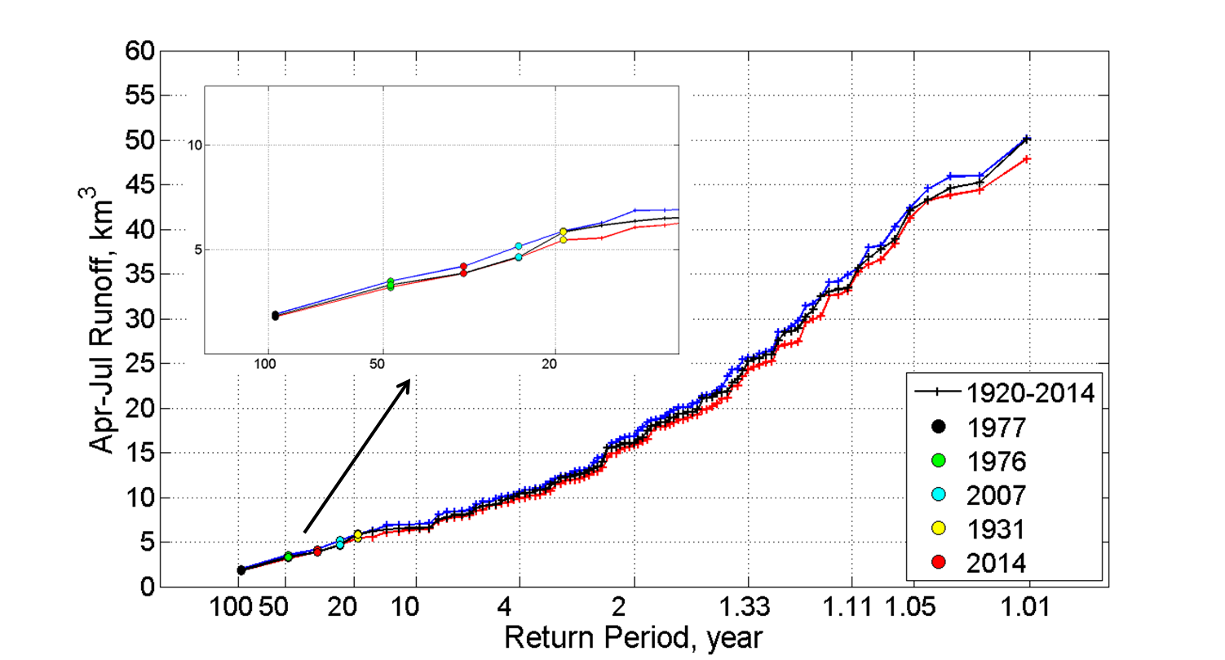
Spring runoff
Weaker decreasing trend without warming
Base scenario
Cold scenario
Warm scenario
Notes:
(don’t talk about the time series and trend)
Similar – warming climate doesn’t affect droughts too much; diverge as runoff goes up

Slide 29
3. Is there a link between climate change and drought events in California?
Warming climate
Decreasing trends in SWE and spring runoff
More severe droughts

Slide 30
3. Is there a link between climate change and drought events in California?
Warming climate
Probably
Decreasing trends in SWE and spring runoff
More severe droughts

Slide 31
3. Is there a link between climate change and drought events in California?
Warming climate
Probably
Not so much
Decreasing trends in SWE and spring runoff
More severe droughts
Notes:
Based on all our analysis

Slide 32
Conclusions

Slide 33
Conclusions
Lots of natural variability in the record
SWE primarily correlated with winter precipitation, secondarily with winter temperature
The warming climate does not affect extreme drought events too much
Climate change might have slightly exacerbated the 2014 drought (anomalously warm winter)
But these kinds of extreme drought events in the Sierra Nevada are mainly due to natural variability in precipitation

Slide 34
Postscript
What about model error (VIC appears to underestimate SWE)?
What about multiyear droughts?
Other studies saying this was/is “drought of the millenium” etc
Why are you looking at such a small area (other studies based on all of CA)?

Slide 35
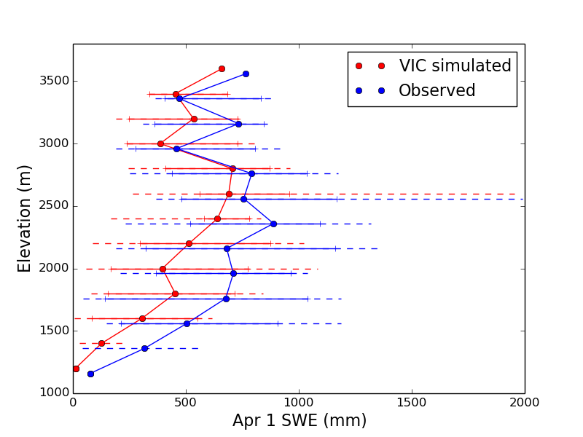

Slide 36
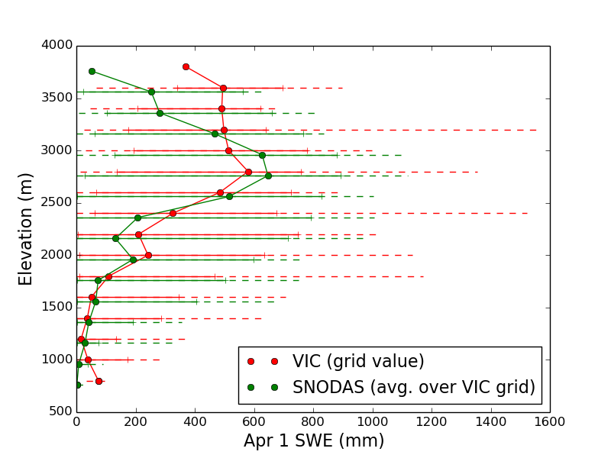

Slide 37
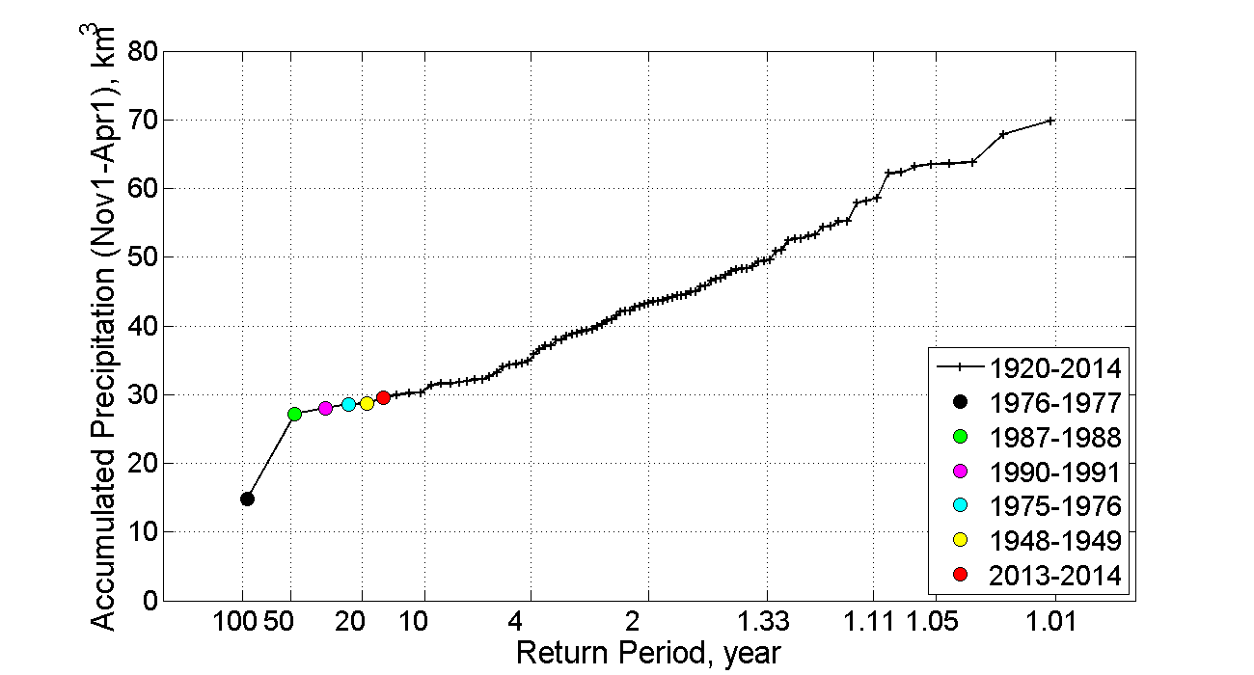

Slide 38
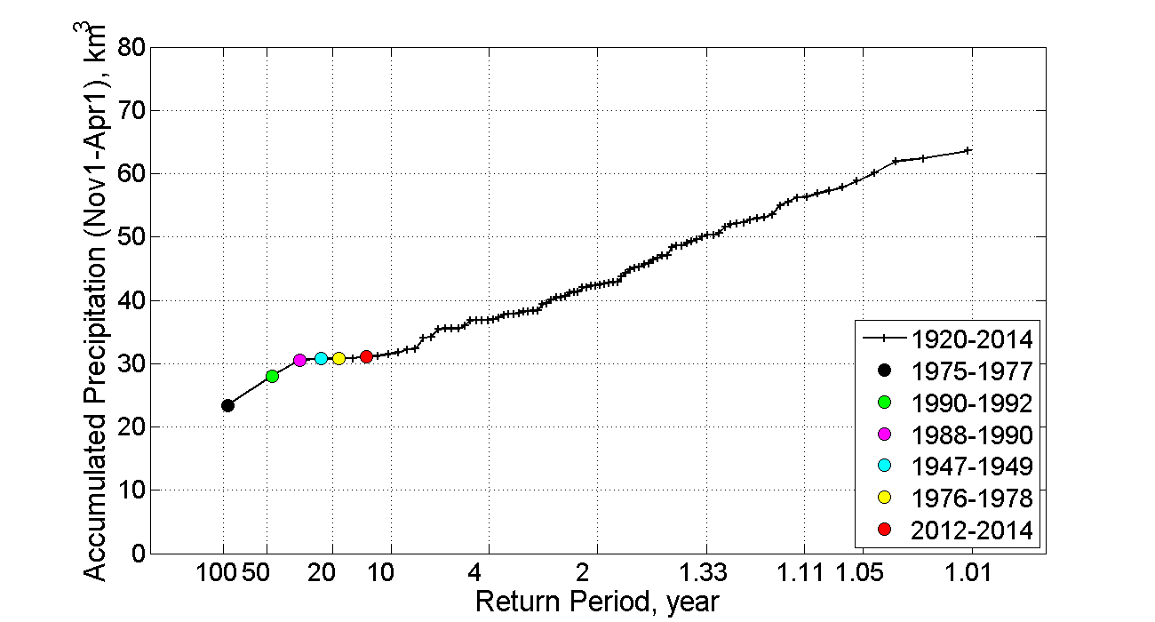

Slide 39
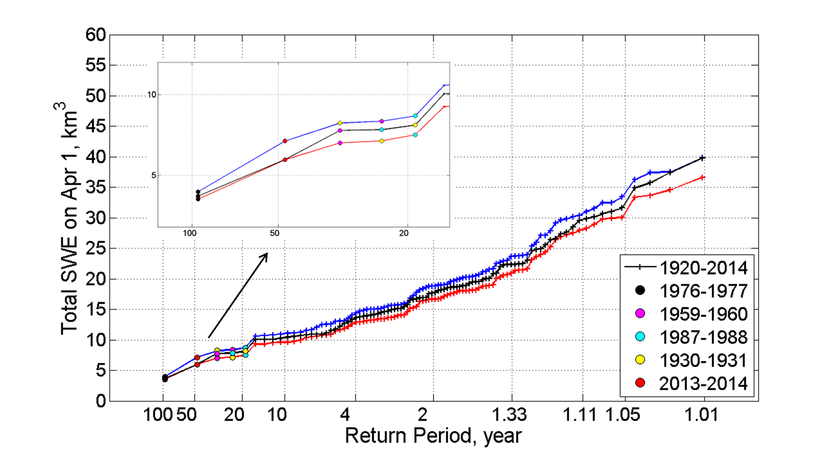

Slide 40
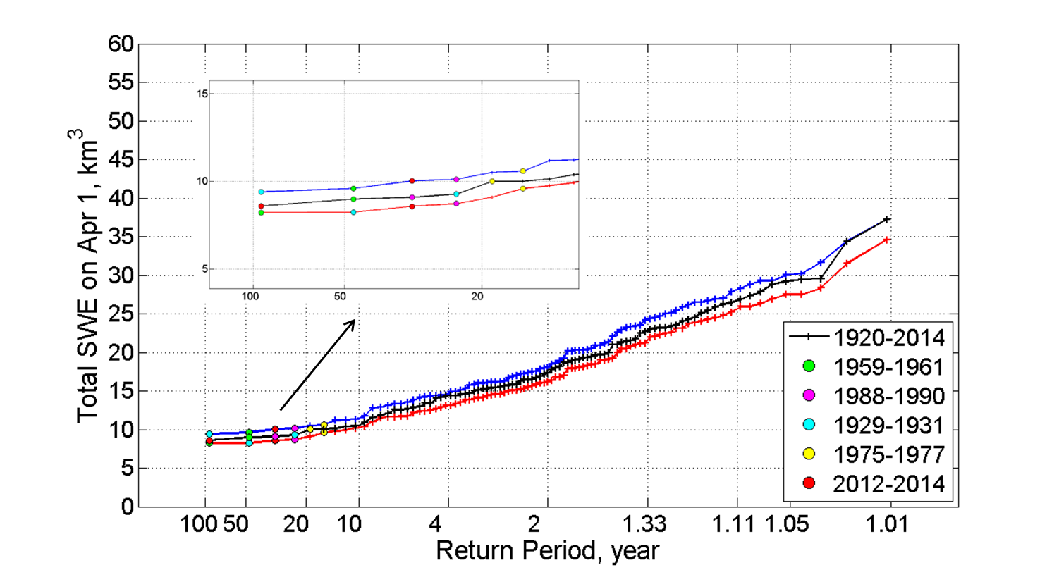

Slide 41
“A highly persistent largescale meteorological pattern over the northeastern Pacific led to observationally unprecedented geopotential height and precipitation anomalies over a broad region. The very strong ridging and highly amplified meridional flow near the West Coast of North America in 2013/14 was structurally similar to—but spatially and temporally more extensive than—atmospheric configurations that have been previously linked to extreme dryness in California. We find that extreme geopotential height values in this region, which are a defining metric of this type of atmospheric configuration, occur much more frequently in the present climate than in the absence of human emissions.” Swain et al., 2014

Slide 42
“Our model results [suggest] that atmospheric internal variability accounts for the extreme magnitude of this climate event. An assessment of the role of the long-term warming trend shows that it [results] in less North Pacific storms reaching California. The warming trend, however, also leads to increased atmospheric humidity over the northeast Pacific, thus, facilitating wetter events over California. The above two effects [lead to] no appreciable long-term change in the risk for dry climate extremes over California since the late 19th century.” Wang and Schubert, 2014

Slide 43
“While the SST trend mode has resulted in large SST increases … the location of most of this warming is to the west of the key sensitivity areas identified in our CMIP5 composite. While this trend pattern does resemble SST variations associated with drying in the western United States, removing this warming did not increase the [model] precipitation over California in a statistically significant manner; thus, our results do not indicate that this long-term warming trend contributed substantially to the 2013 and 2014 drought events. This result appears consistent with the lack of a long-term downward trend in California precipitation.” Funk et al., 2014

Slide 44
“… the combination of extreme precipitation and temperature conditions observed in 2014 in California appears to be a 200 year extreme event.” AghaKouchak et al., 2014

Slide 45
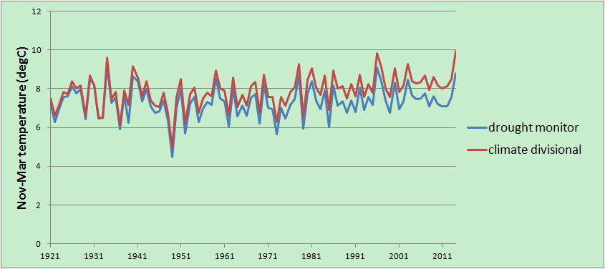
Drought monitor and NCDC climate division data, winters (Nov-Mar) 1915-2014

Slide 46
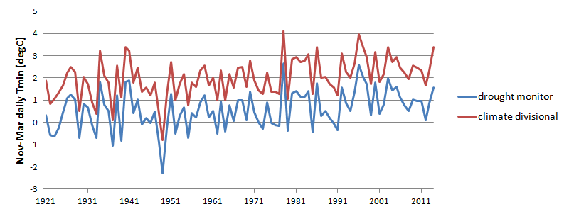
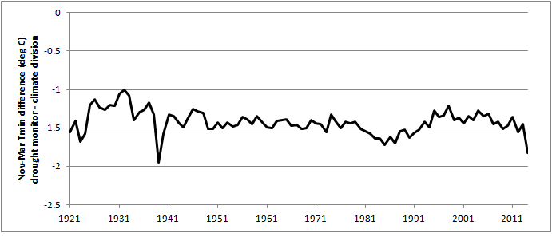
Winter Tmin, SWM and NCDC Climate Division

Slide 47
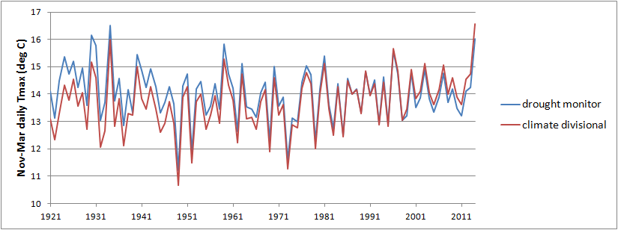
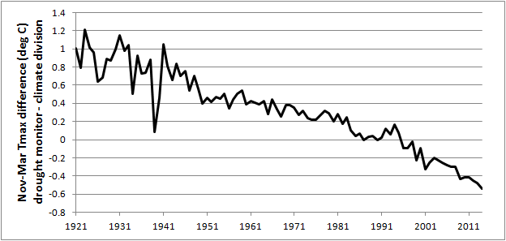
Winter Tmax, SWM and NCDC Climate Division

Slide 48
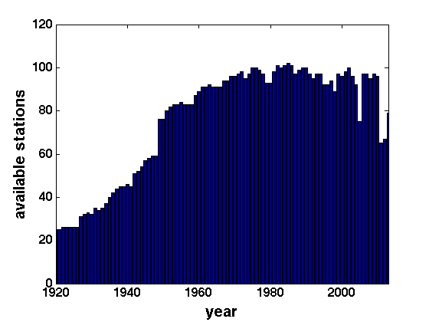
Total SWM stations in CA, 1915-2014

Slide 49
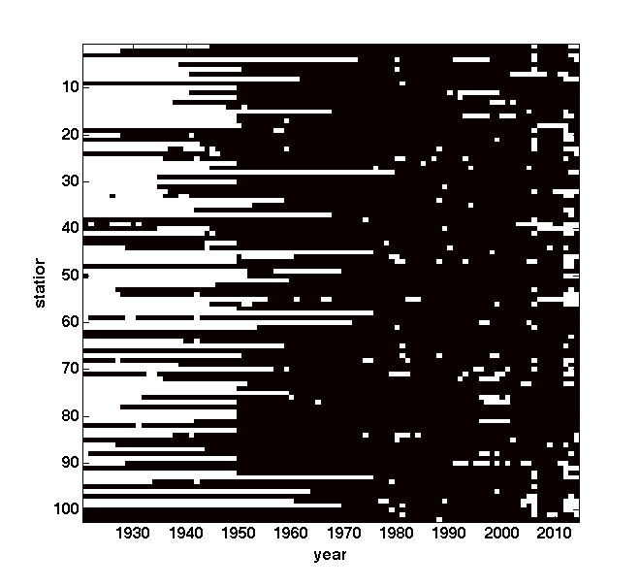
Reporting history of CA SWM stations (80% completeness)

