Slide 1
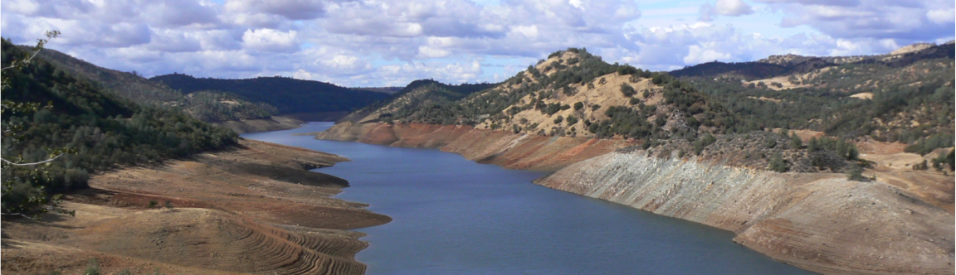

Implications of a changing climate for flood risk
Dennis P. Lettenmaier
Department of Geography
University of California, Los Angeles
Climate Roundtable, “Precipitation in the U.S.”
FM Global, Boston
Jan 12, 2015

Slide 2
Motivating question: As the climate (and presumably precipitation and precipitation extremes) change, what will happen (is happening) to flood risk?

Slide 3
Outline of this talk
What causes a flood?
Evidence for changes in U.S. flood risk
Sensitivities and projections
How good are the models?

Slide 4
What causes a flood?
Extreme precipitation
Precipitation duration relative to catchment response time (“time of concentration”)
Soils, topography, and (lesser extent) vegetation
Catchment and storm geography; storm movement relative to catchment geography
Antecedent conditions (soil moisture)
Other factors (e.g., snow; frozen ground)

Slide 5
Dominant processes governing catchment storm response
CATCHMENT SIZE
large river flooding
flash flood
small
medium
large
DOMINANT PROCESS
precipitation
hydrological processes
channel processes

Slide 6
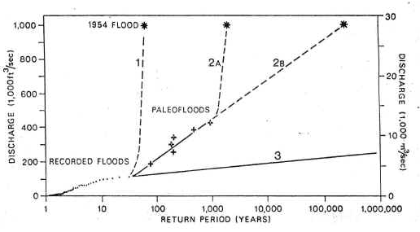
Issues in the historical record
Pecos River flood frequency distribution (from Kochel et al, 1988)

Slide 7
Evidence for changes in U.S. flood risk

Slide 8
A warmer climate, with its increased climate variability, will increase the risk of both floods and droughts
IPCC WG2, 2007

Slide 9
Most climate scientists agree that global warming will result in an intensification, acceleration or enhancement of the global hydrologic cycle, and there is some observational evidence that this is already happening.
UNESCO World Water Development Report Water in a Changing Climate, 2009

Slide 10
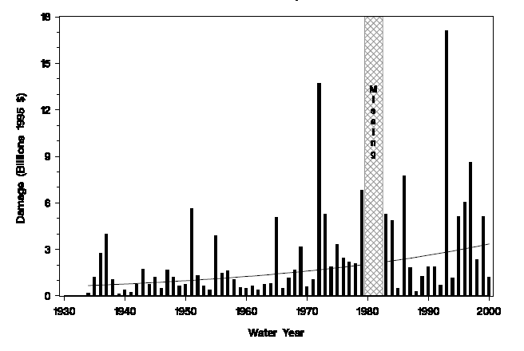
Total U.S. flood damages, 1934-2000
from Pielke et al., 2000

Slide 11
First, (extreme) precipitation trends

Slide 12
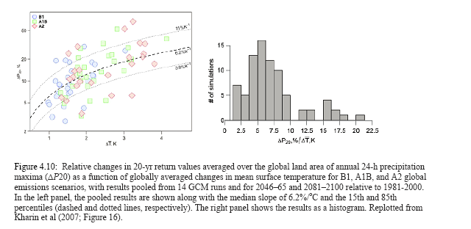
Extreme precipitation should be increasing as the climate warms

Slide 13
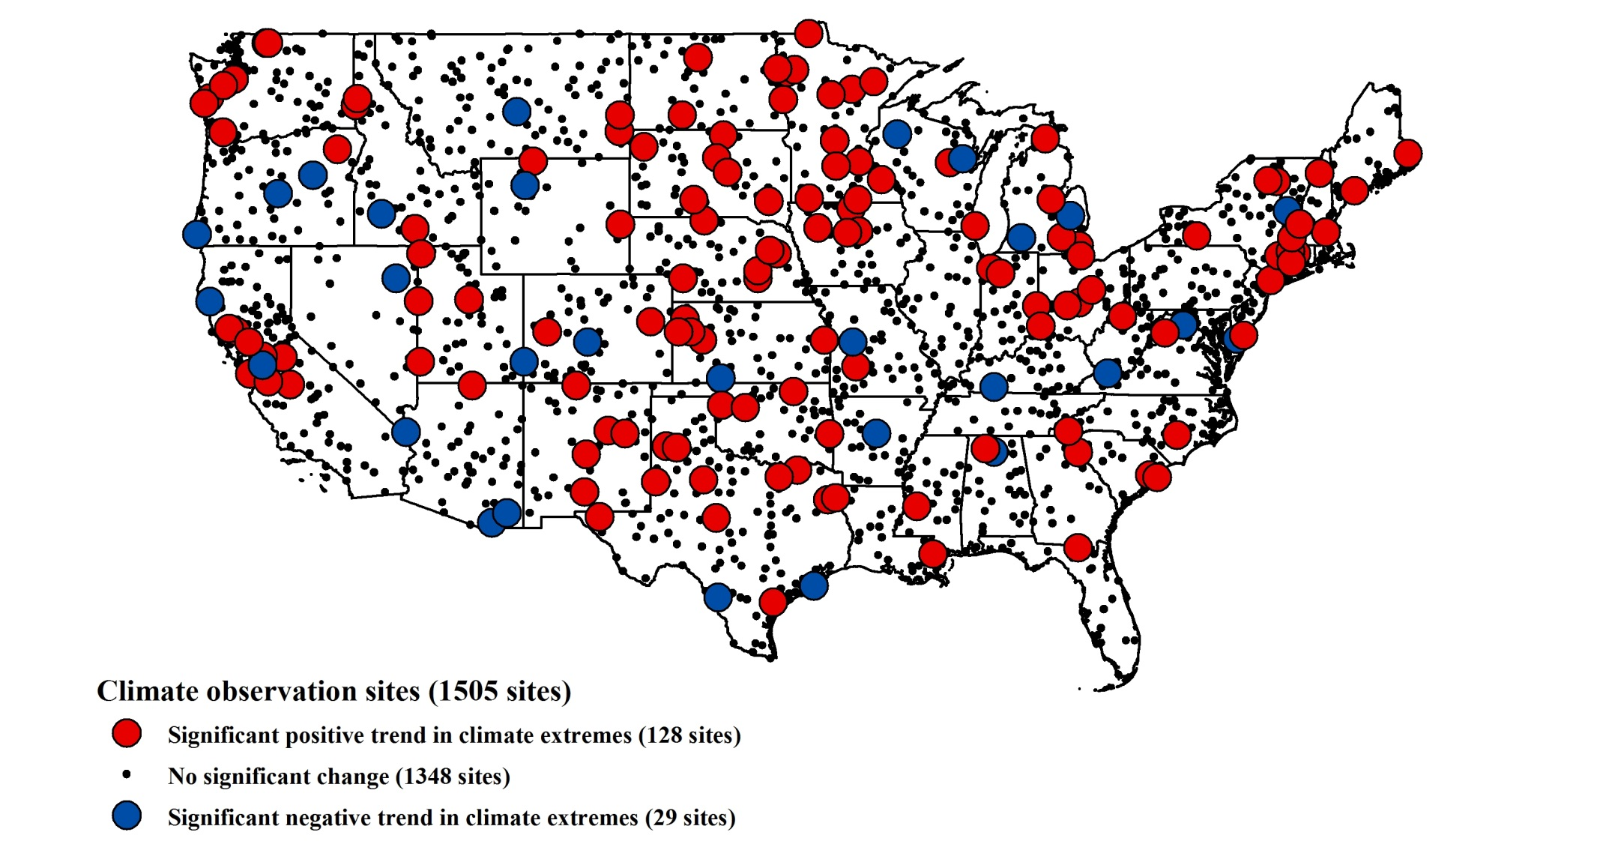
Relationship between annual daily maximum precipitation distribution and global mean temperature (red significantly positive, blue significantly negative, other no relationship)
replotted from Westra et al., J Clim, 2013

Slide 14
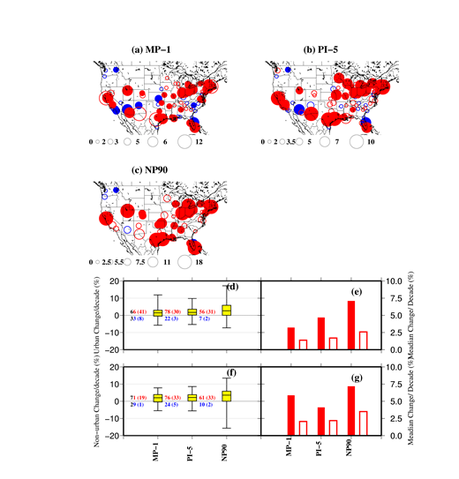
Trends in annual precipitation maxima in 100 largest U.S. urban areas, 1950-2009
from Mishra and Lettenmaier, GRL 2011

Slide 15
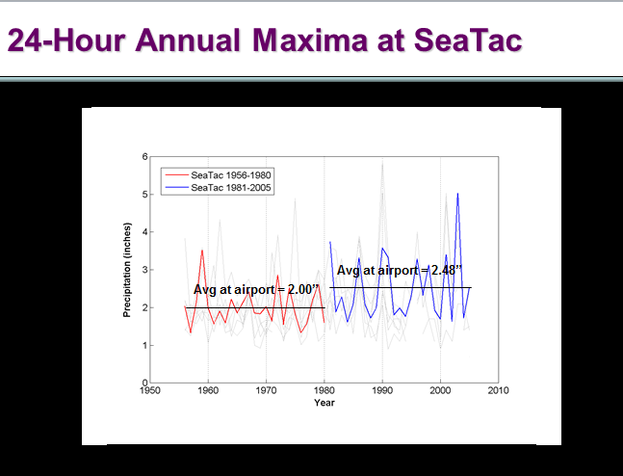

Slide 16
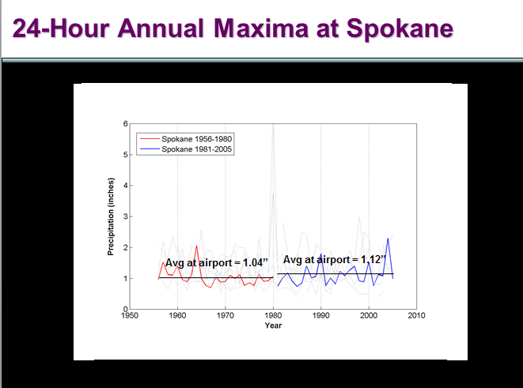

Slide 17
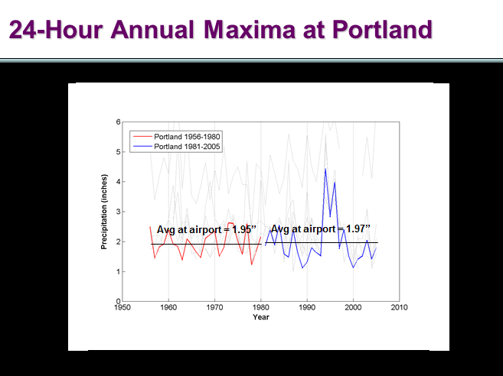

Slide 18
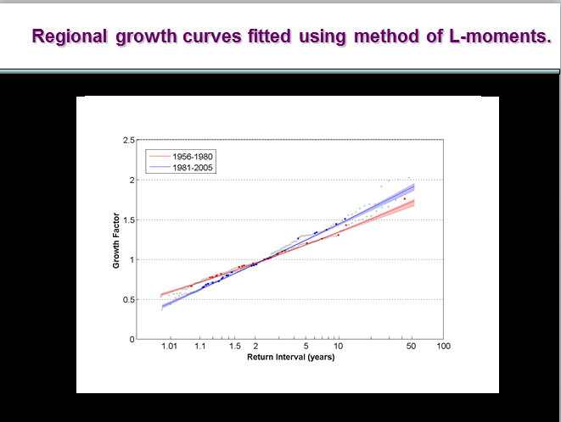

Slide 19
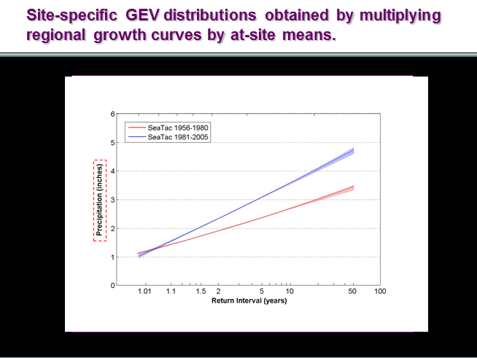

Slide 20
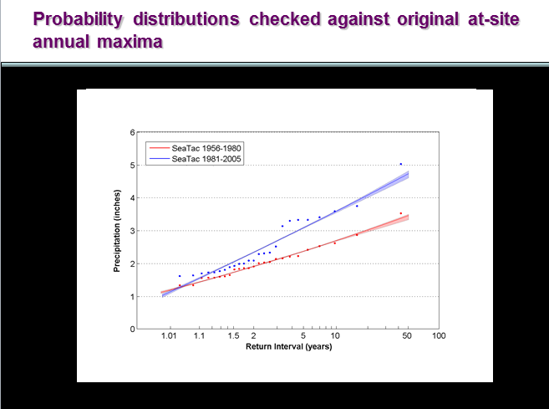

Slide 21
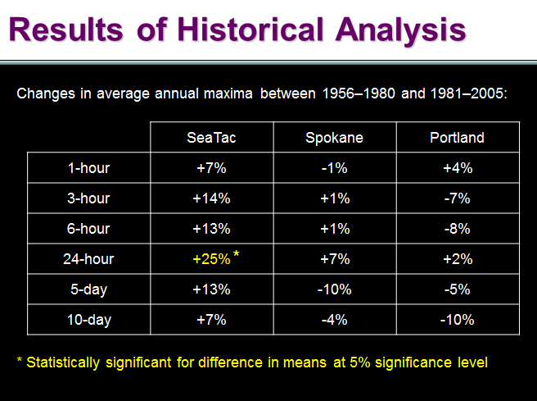

Slide 22
So what about flooding?

Slide 23
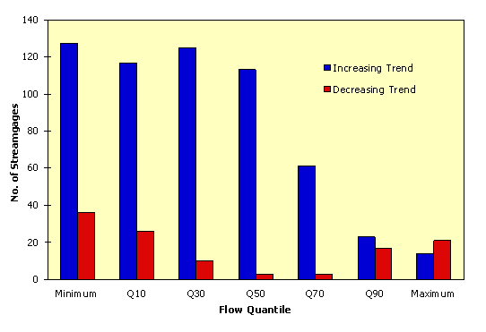
Number of statistically significant increasing and decreasing trends in U.S. streamflow (of 395 stations) by quantile (from Lins and Slack, 1999)

Slide 24
About 10% of the 400 sites show an increase in annual maximum flow from 1941-71 to 1971-99
Maximum flow
Increase
No change
Decrease
Visual courtesy Bob Hirsch, figure from McCabe & Wolock, GRL, 2002
Notes:
Location of sites with significant (based on t-change) change in annual maximum flow.

Slide 25
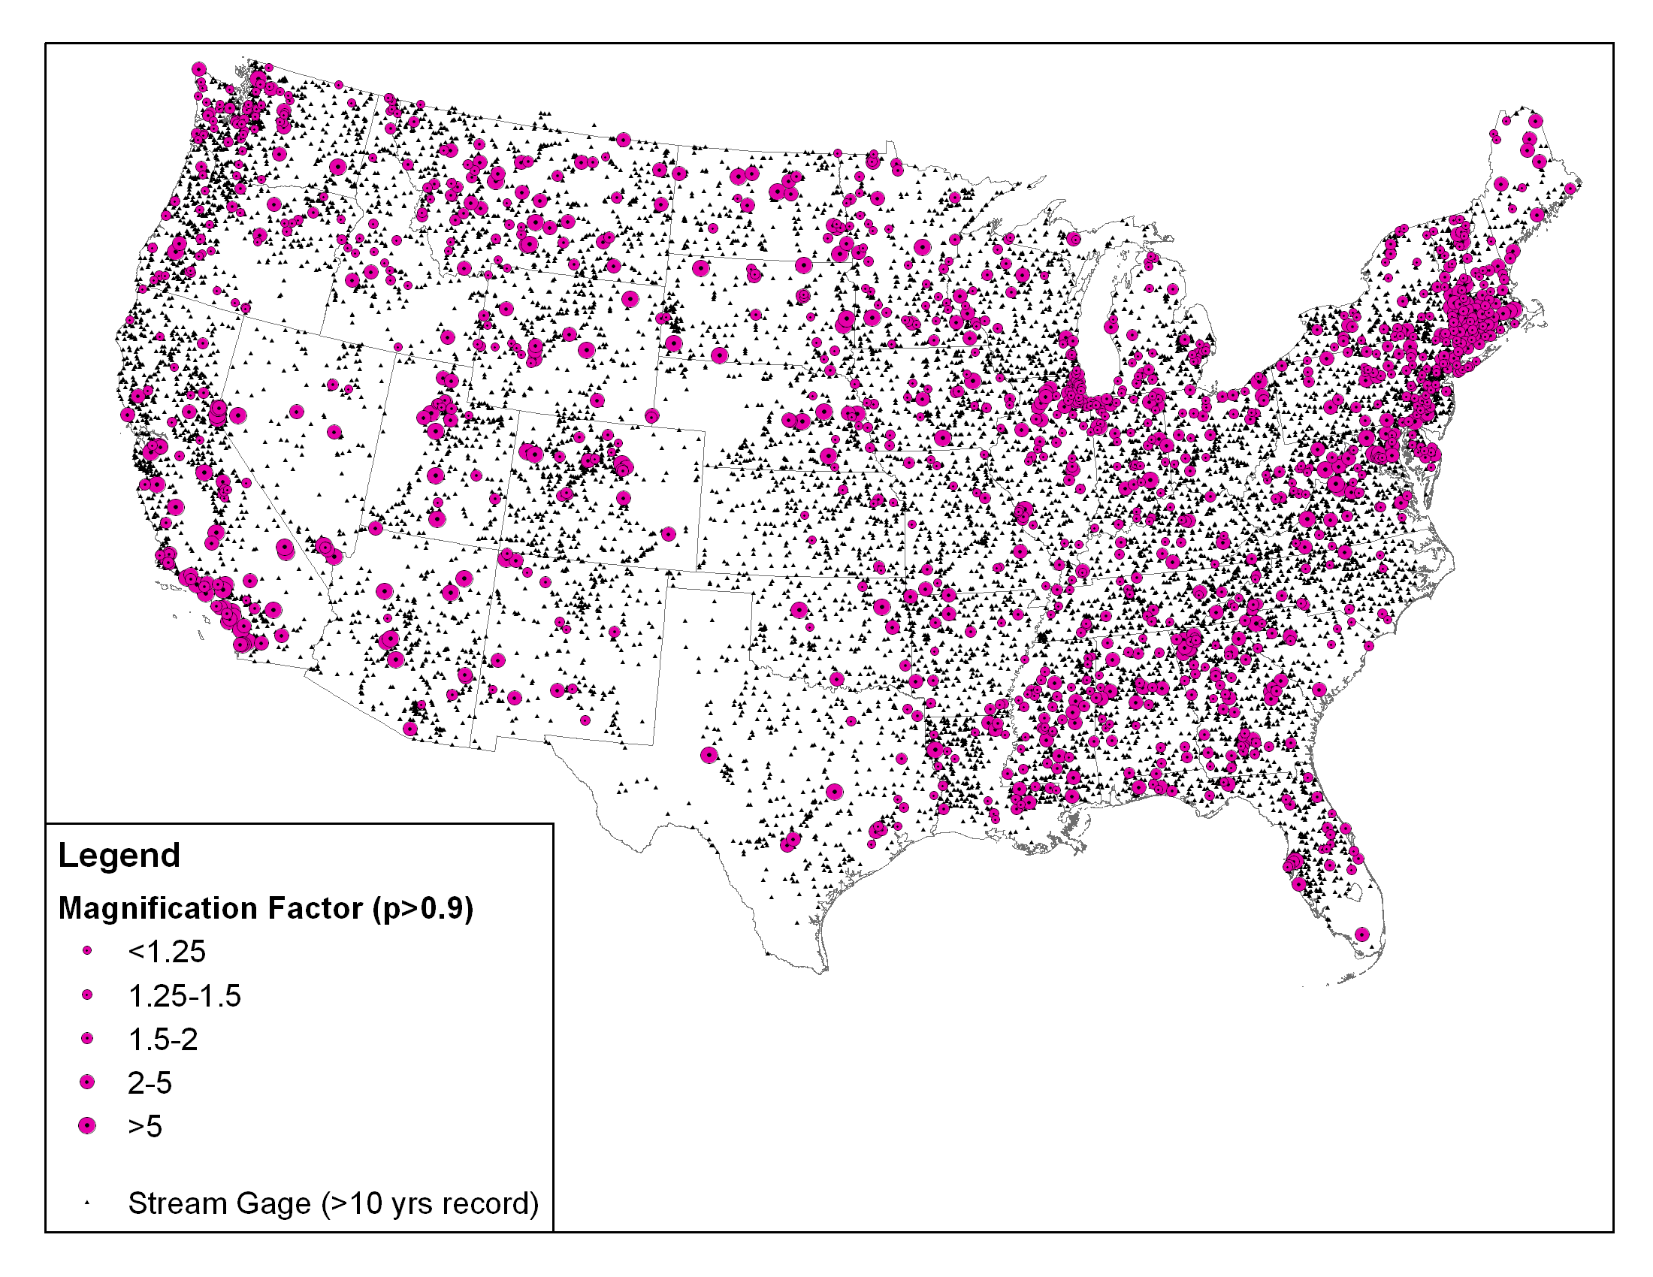
From Yaindl and Vogel, 2009
Decadal Magnification Factors of Floods – Sites w/ no regulation
1,642 of 14,893 USGS Gage Sites with M>1 and p>0.9
visual courtesy Rich Vogel

Slide 26
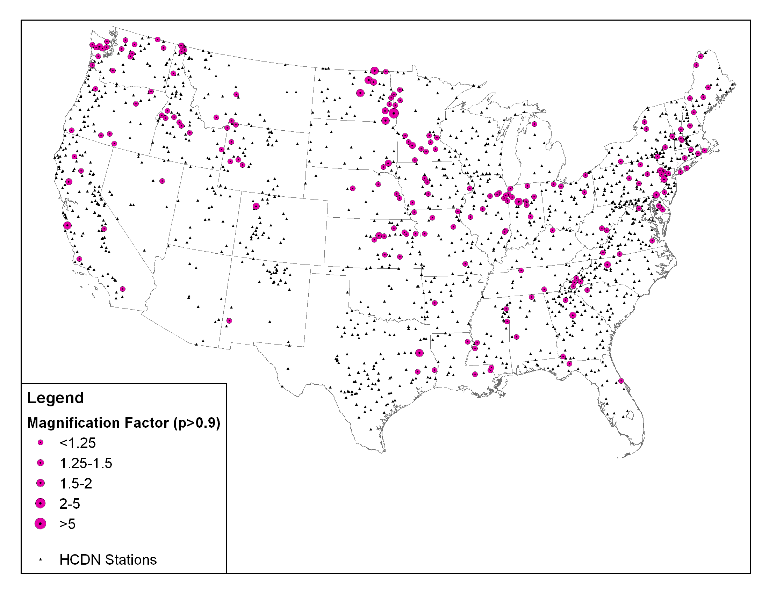
From Yaindl and Vogel, 2011
Decadal Flood Magnification Factors - HCDN Sites
208 of 1,588 HCDN Gage Sites with M>1 and p>0.9
visual courtesy Rich Vogel

Slide 27
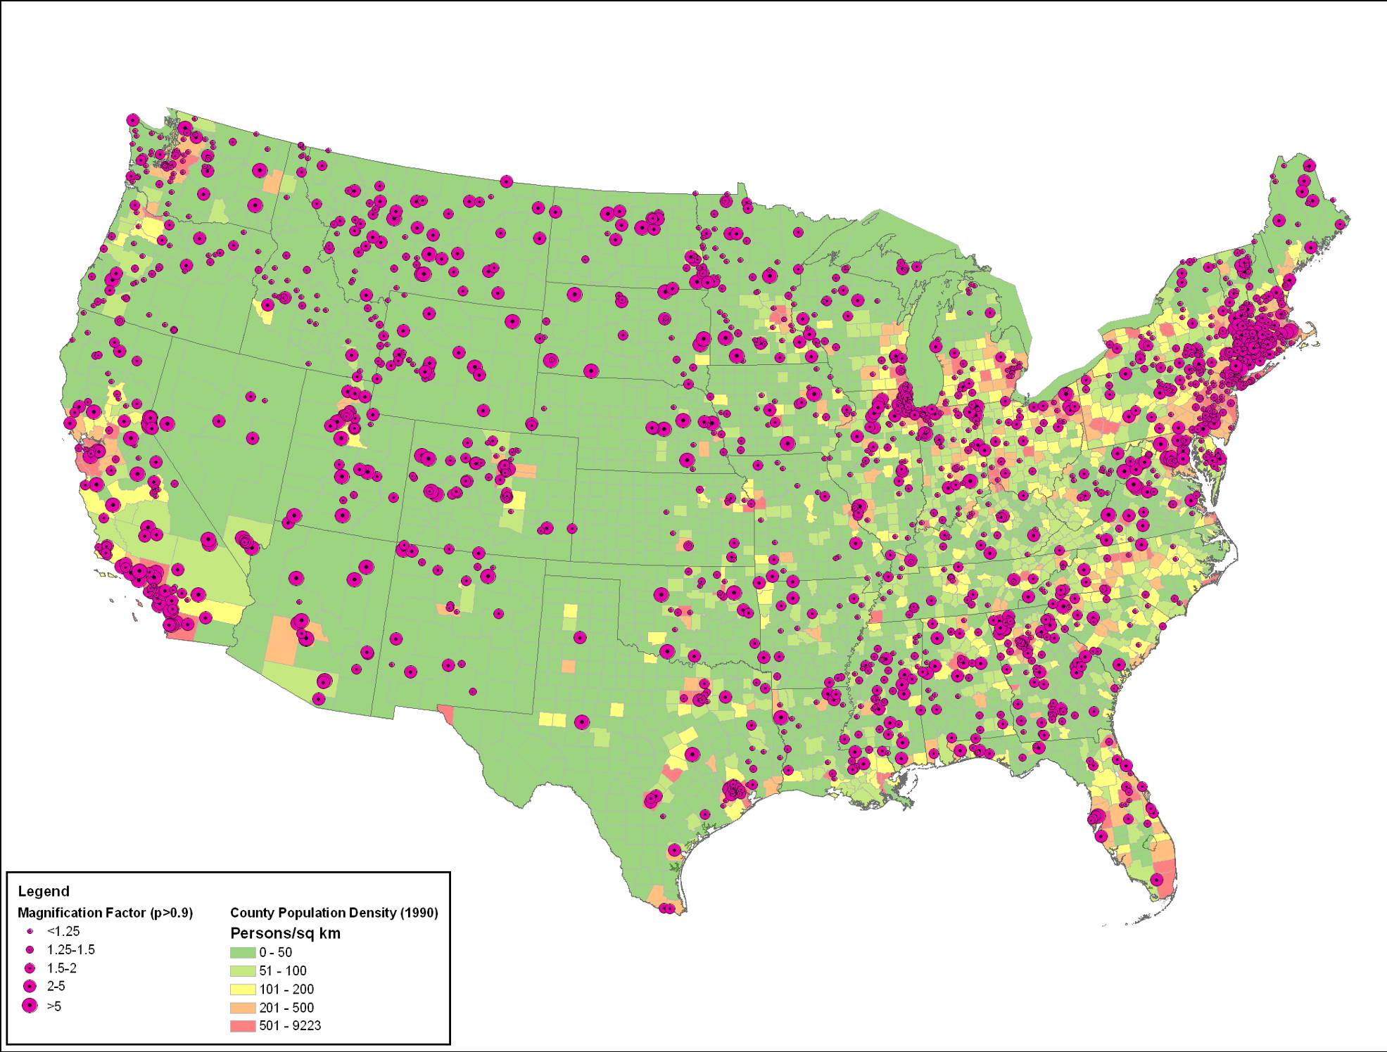
Decadal Flood Magnification Factors
Sites With No Regulation
From Yaindl and Vogel, 2011
visual courtesy Rich Vogel

Slide 28
Results
Decadal Flood Magnification Factors
3 Groups of USGS Gages
From Yaindl and Vogel, 2011
visual courtesy Rich Vogel

Slide 29
Paradox: Given increases in precipitation and runoff, why are there so few significant trends in floods?
Visual courtesy Tim Cohn, USGS

Slide 30
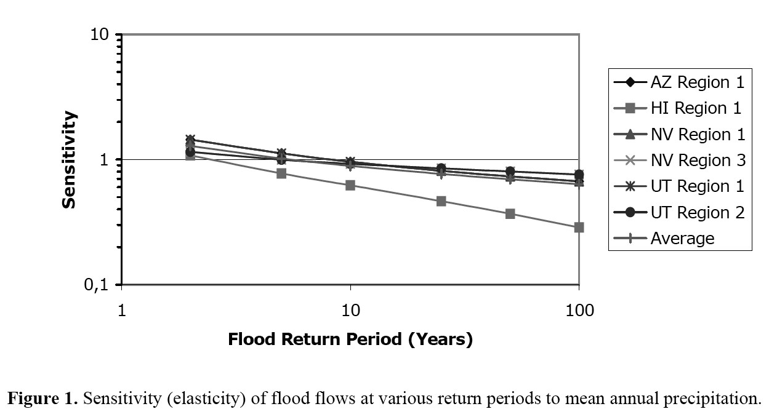
Possible explanation
[Lins and Cohn, 2002]
Visual courtesy Tim Cohn, USGS
Notes:
From USGS regional regression equations

Slide 31
Sensitivities and projections

Slide 32
Predicting urban flooding in a future climate – Thornton Creek example

Slide 33
Global Climate Models
ECHAM5
• Developed at Max Planck Institute for Meteorology (Hamburg, Germany)
• Used to simulate the A1B scenario in our study
CCSM3
• Developed at National Center for Atmospheric
Research (NCAR; Boulder, Colorado)
• Used to simulate the A2 scenario in our study

Slide 34
Global Climate Models
ECHAM5
CCSM3
Mote et al 2005
Notes:
Note: A2 scenarios are solid, B1 scenarios are dashed

Slide 35
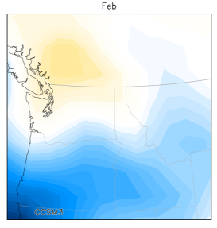
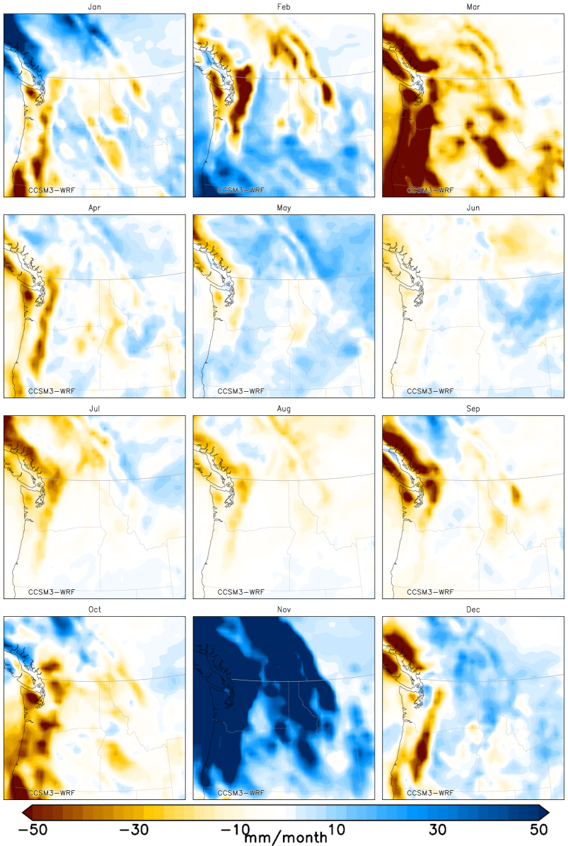
Dynamical Downscaling
Global Model
Regional Model
Courtesy Eric Salathé

Slide 36
Results of Future Analysis
Changes in average annual maximum precipitation between 1970–2000 and 2020–2050:
 | SeaTac | Spokane | Portland
1-hour | +16% | +10% | +11%
24-hour | +19% | +4% | +5%
CCSM3/WRF
*
*
ECHAM5/WRF
1-hour | -5% | -7% | +2%
24-hour | +15% | +22% | +2%
*
*
* Statistically significant for difference in means and distributions, and non-zero temporal trends

Slide 37
Results of Bias Correction -- SeaTac
Comparison of changes in average annual maximum between 1970–2000 and 2020–2050:
 | Raw Change | Corrected Change
1-hour | +16% | +14%
24-hour | +19% | +28%
*
*
CCSM3
1-hour | -5% | -6%
24-hour | +15% | +14%
ECHAM5
*
*
* Statistically significant for difference in means and distributions, and non-zero temporal trends

Slide 38
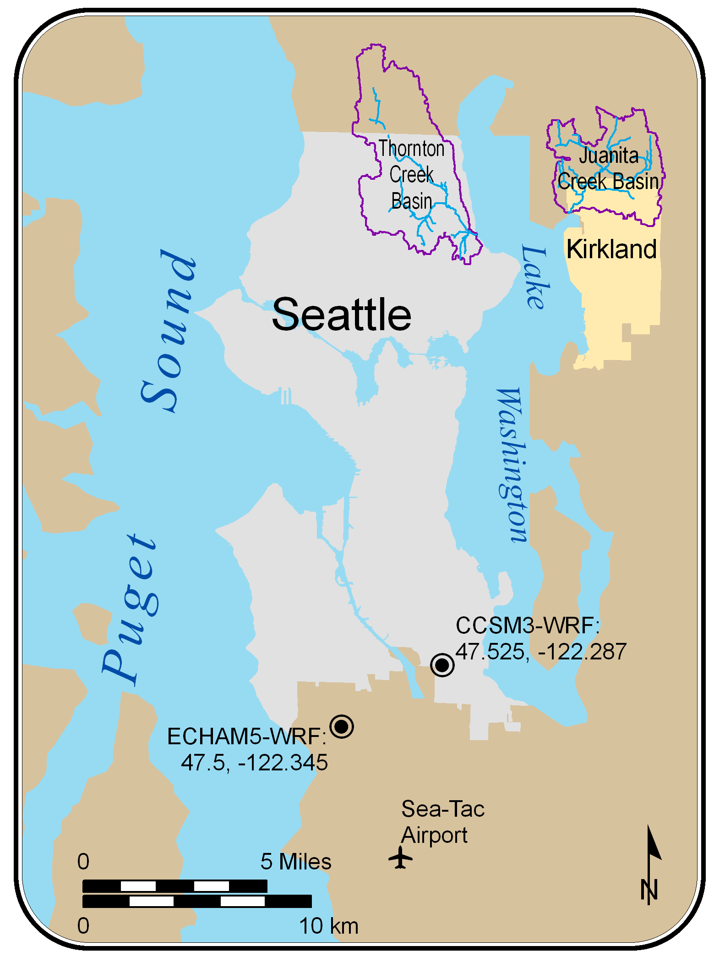
Thornton Creek

Slide 39
Results of Hydrologic Modeling
Changes in average annual maxima streamflow at outlet of watershed between 1970-2000 and 2020-2050:
 | Juanita Creek | Thornton Creek
CCSM3 | +25% | +55%
ECHAM5 | +11% | +28%
*
*
* Statistically significant for difference in means

Slide 40
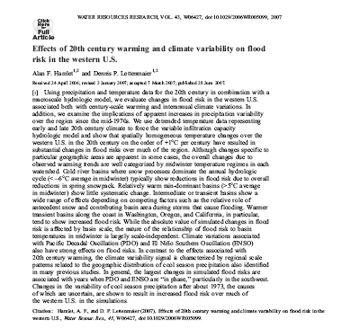

Slide 41
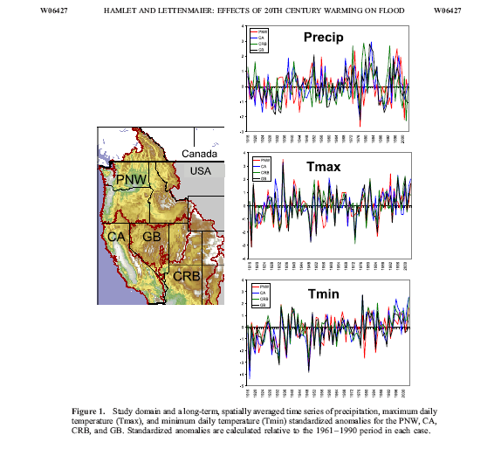

Slide 42
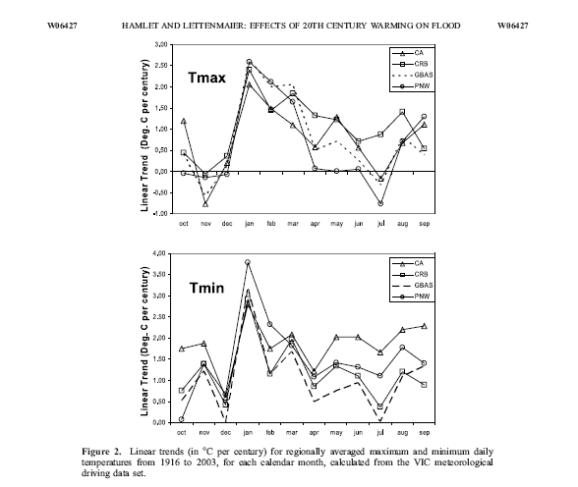

Slide 43
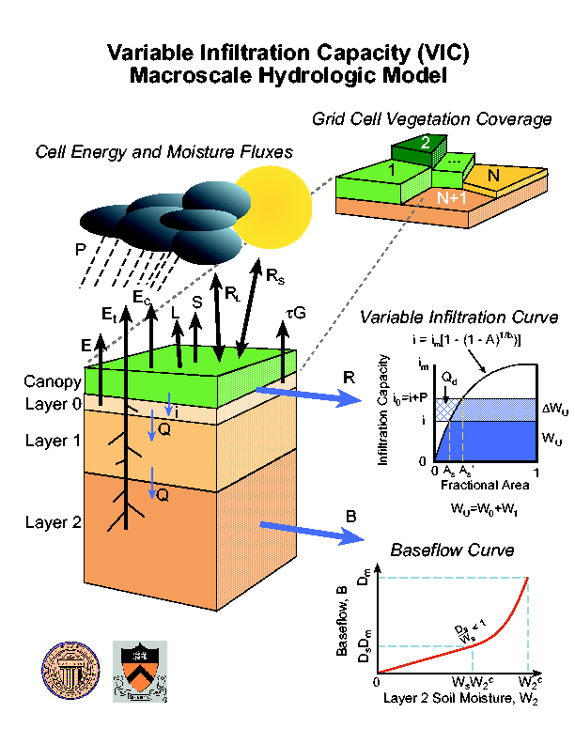
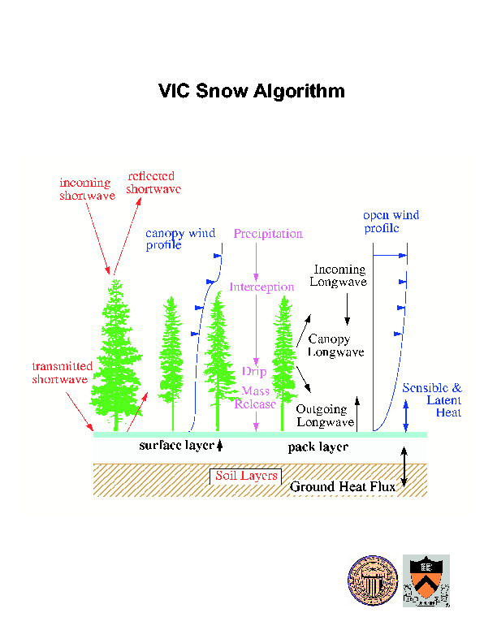
Hydrological modeling (forced at the land surface with P, T, …)

Slide 44
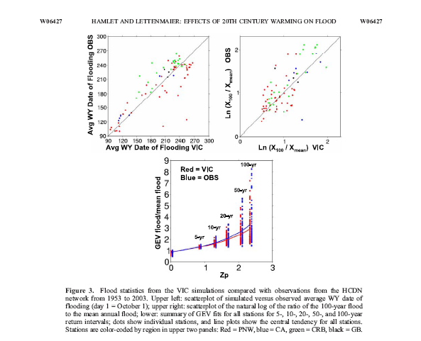

Slide 45
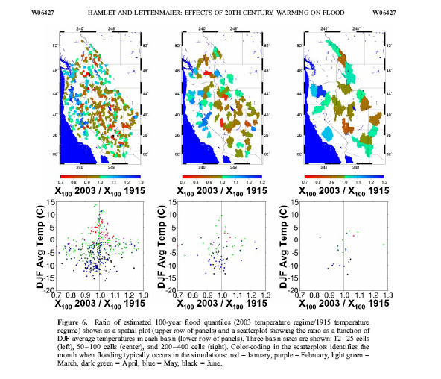

Slide 46

Simulation Approach
  10 GCMs from CMIP5: CCSM4, NorESM-1, bcc-csm1-1-m, CanESM2, HadGEM2-CC365, HadGEM2-ES365, MIROC5, IPSL-CM5A-MR, CSIRO-Mk3-6-0,CNRM-CM5
  3 Scenarios: Historical (1950-2005), RCP4.5 (2006-2100) and RCP8.5 (2006-2100)
P and T
MACA Downscaling Method (to 1/16 deg spatial resolution)
P and T
Variable Infiltration Capacity Model
Runoff, SWE
Multi-Model Ensemble Average
Notes:
Here we use a subset of ten of the IPCC 5th Assessment Report (AR5) global climate models as archived by the Coupled Model Intercomparison Project 5 (CMIP5). These were chosen by comparing precipitation and temperature data from the gcms to 20th century observations and determining “best performers” due to a number of metrics, including diurnal variation, amplitude of seasonal cycle. for more on this, see Rupp et al 2013)
MACA downscaling: (see Abatzoglou and Brown 2011) is a statistical downscaling method that utilizes a meteorological observation dataset as training data to eliminate historical biases and to match spatial patterns in climate model output.
Downscaled from native resolution of GCMs (which varies across GCMs) to 4 or 6 km.
Scenarios: 1950-2005 for historical, 2006-2100 for RCP4.5 and 8.5. Representative concentration pathways correspond to different levels of radiative forcing due to greenhouse gas emissions, relative to pre-industrial levels. 4.5 is a ‘business as usual’ scenario, where emissions peak around 2040 and then decline. in 8.5, emissions continue to rise throughout the 21st century.
VIC model: macroscale, semi-distributed land surface hydrologic model
For this study, we are concerned with how RCP4.5 and 8.5 will impact flood frequency across the Pacific Northwest region of the United States.

Slide 47
Assessment of potential flood changes in PNW based on (10) CMIP5 scenarios

Slide 48
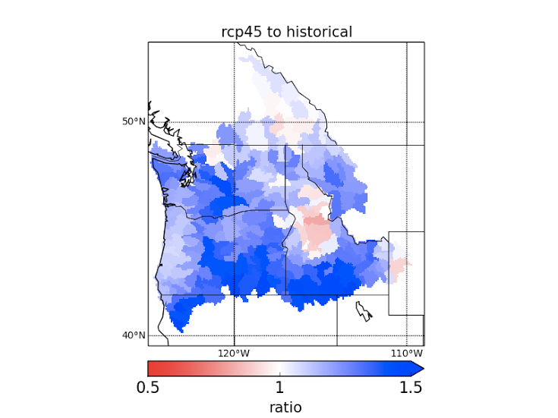
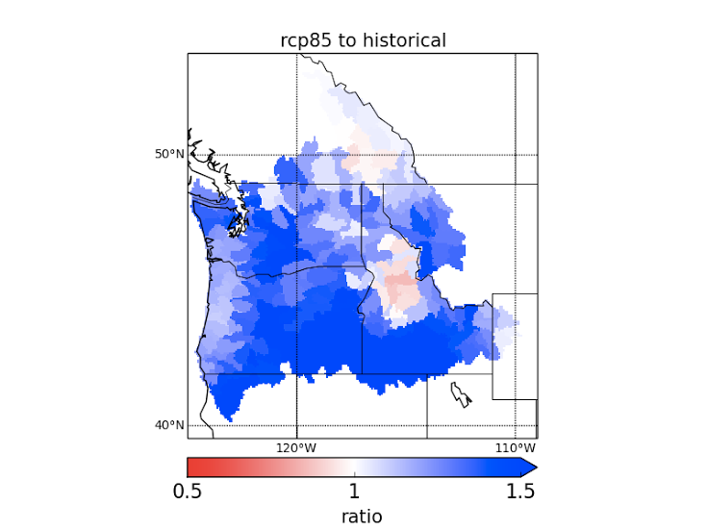
Future Changes in the Mean Annual Maximum Flood
Notes:
For this analysis, we take the annual maximum 24-hr runoff for each year of the period, 1950 to 2005 for historical, 2006-2100 for rcp 4.5 and 8.5, and take the mean of the maxima over the time period. The left plot is the ratio of the mean for 4.5 to historical, and the right side is the ratio of the mean for 8.5 to historical. Here the ratio ranges from 0.5 to 1.5, which corresponds to a range between 50% reduction to 50% increase in the amount of the maximum annual flood.
What we can take from this is that there is an increase in the intensity of the annual maximum flood in almost every part of the Pacific Northwest, excluding Central Idaho, and there is a marked increase in the annual maximum flood between 4.5 and 8.5 scenarios.
We also want to know how the timing of the mean annual maximum flood is changing.

Slide 49
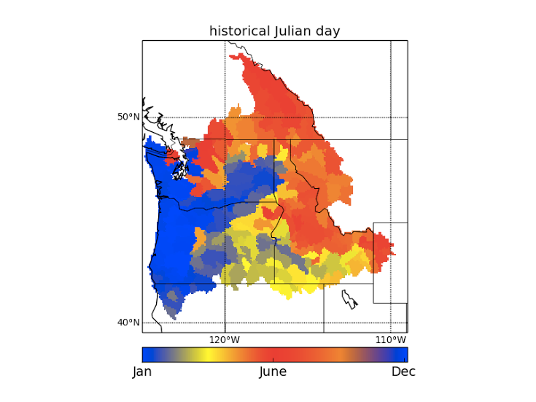
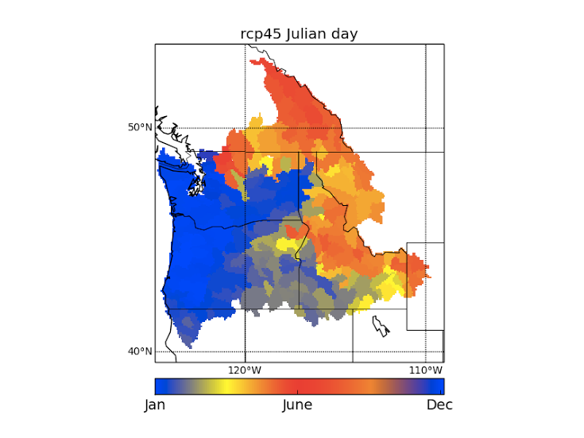
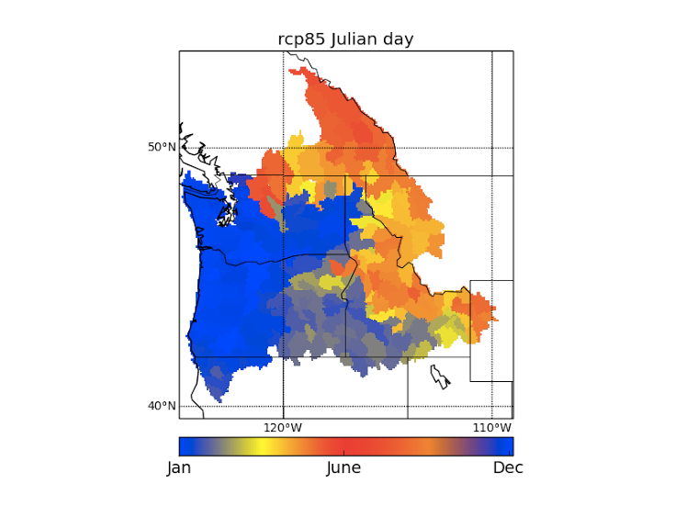
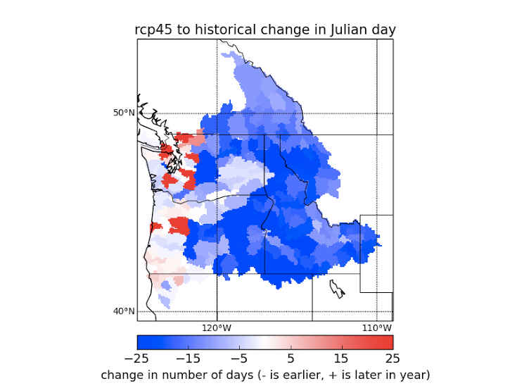
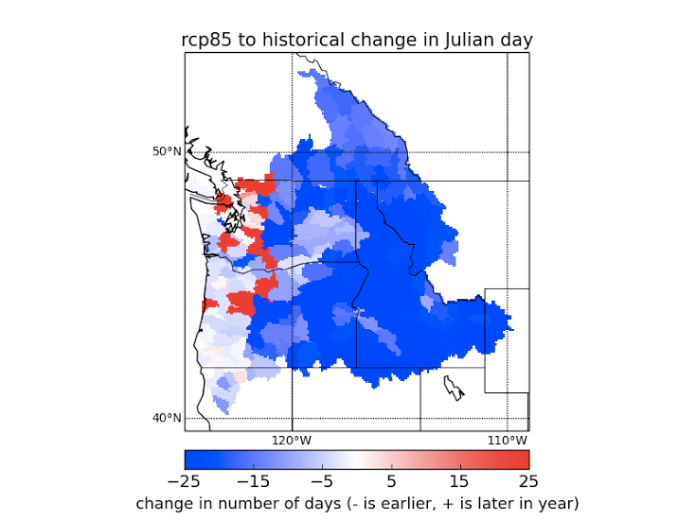
Timing of Annual Maximum Flood
Notes:
The top row shows the timing of the annual maximum flood by showing the Julian day of the year of the flood. The leftmost plot is for the historical period, and the center and rightmost plot show the Julian day for 4.5 and 8.5 respectively.
The bottom row shows the change in the Julian day for 4.5 and 8.5, with white showing no change. We see that the annual maximum flood is moving earlier in the year in almost all cases, and this is particularly strong in the Snake Region and parts of the Northern Rockies, with a shift of 2-3 weeks in many parts of the basin, with a further increase for rcp8.5.
Given these changes in the intensity and timing of the annual maximum flood, we want to ask FLIP TO NEXT SLIDE

Slide 50
Are these changes driven by SWE, Precipitation, or Temperature?

Slide 51
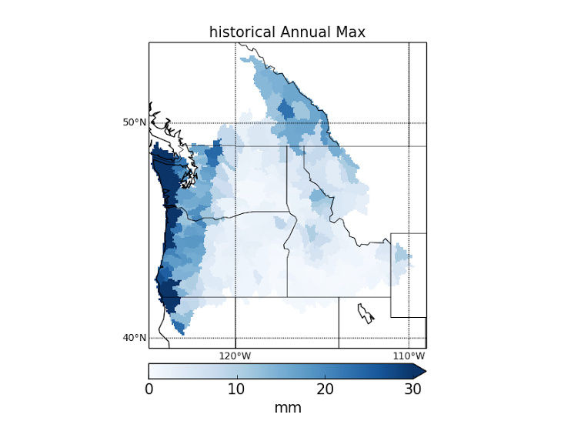
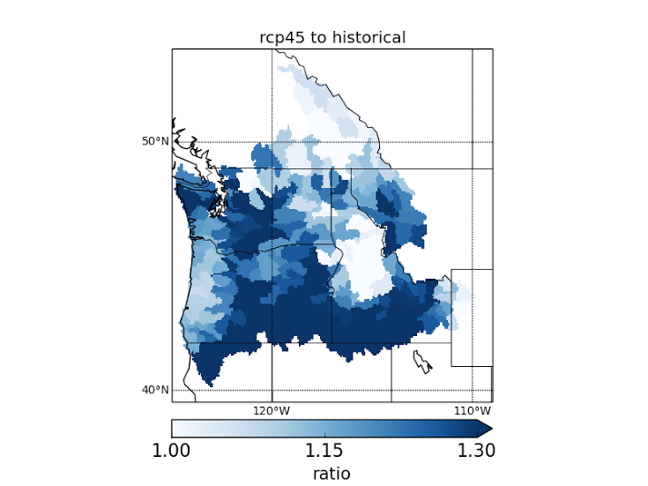
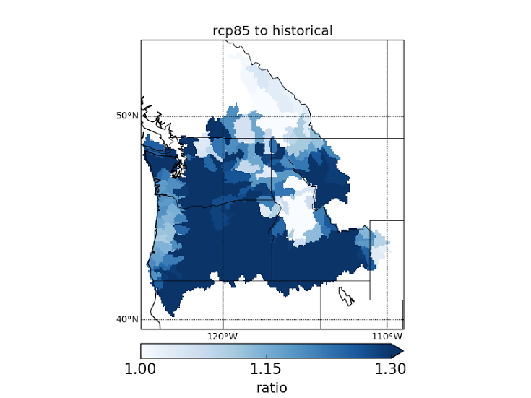
Future Changes in Mean Annual 24-hr Maximum Precipitation
Notes:
Here we run the same analysis as with the mean annual maximum flood, taking the annual maximum 24-hr precipitation for each year of the historical and future periods and the mean over the yearly maxima. the leftmost plot shows the magnitude of the historical annual maximum, and the center and right plots show the ratio of the mean annual maximum precipitation during for the future rcp4.5 scenario to historical and future rcp8.5 scenario to historical, respectively.
We see that there is a very strong increase in the intensity of annual maximum precipitation for the majority of the Pacific Northwest, excluding the Canadian portion of the Pacific Northwest and the Oregon coast. There is a strong increase between 4.5 and 8.5 as well.

Slide 52
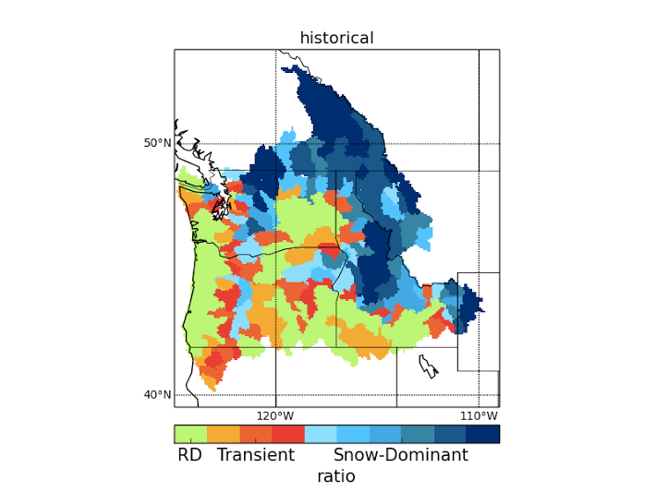
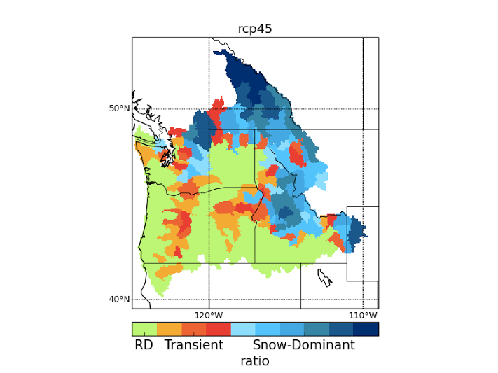
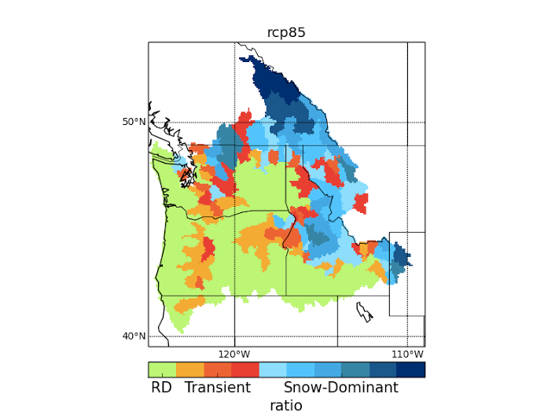
Ratio of April 1 SWE to Cumulative NDJFM Precipitation
0-0.1: Rain Dominant
0.2-0.4: Transient
0.5-1: Snow-Dominant
(see Elsner et al 2010)
Notes:
Based on the warming and precipitation trends discussed earlier, we want to understand how they will drive the hydrology of the Pacific Northwest. Here we use an index that was used in the Elsner et al 2010 paper: we take the ratio of aggregate April 1 Snow water equivalent to cumulative winter precipitation to classify basins as rain dominant, transient, or snow dominant. Ratios of 0-0.1 represent rain dominant basins, 0.2-0.4 are transient, and 0.5-1 are snow-dominant, to varying degrees.
Studies have shown that climate change will push transient basins toward being rain dominant. We see this effect in our simulations, with a more and more transient basins in the interior and the Snake Region becoming rain dominant. We also see watersheds in the Northern Rockies becoming less and less snow dominant between the historical to rcp8.5 scenarios.

Slide 53
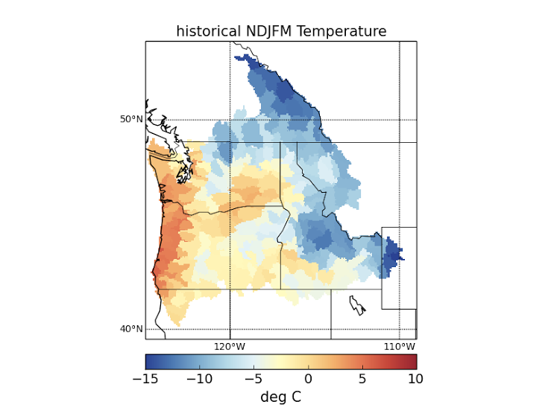
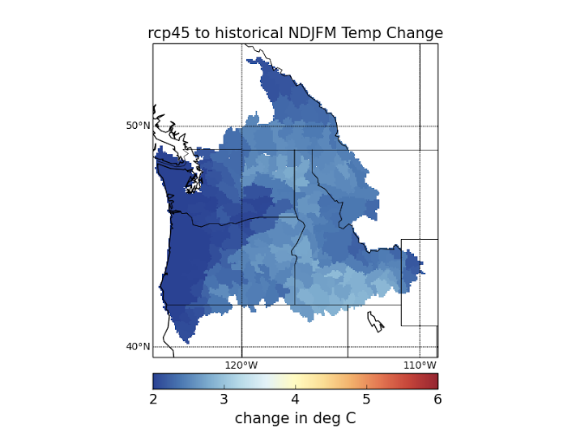
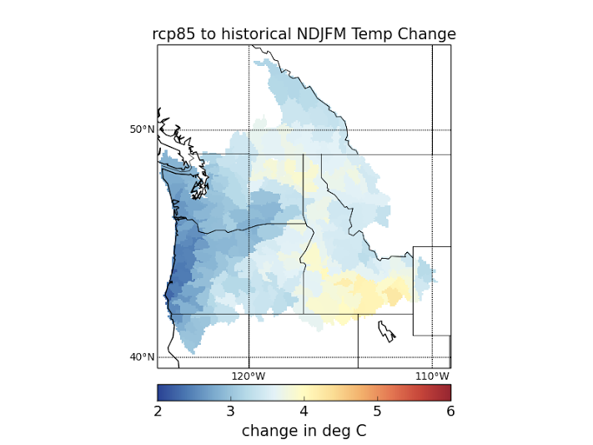
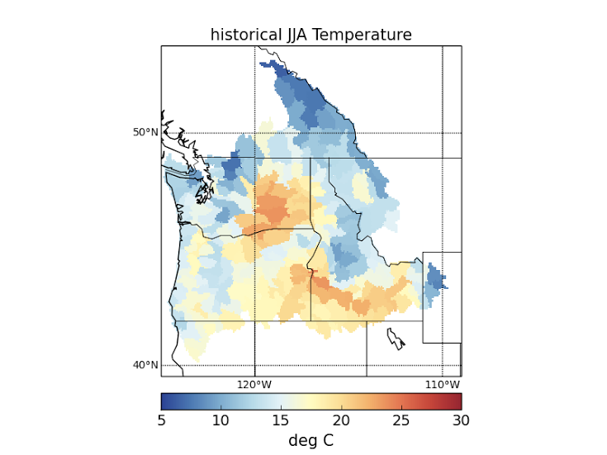
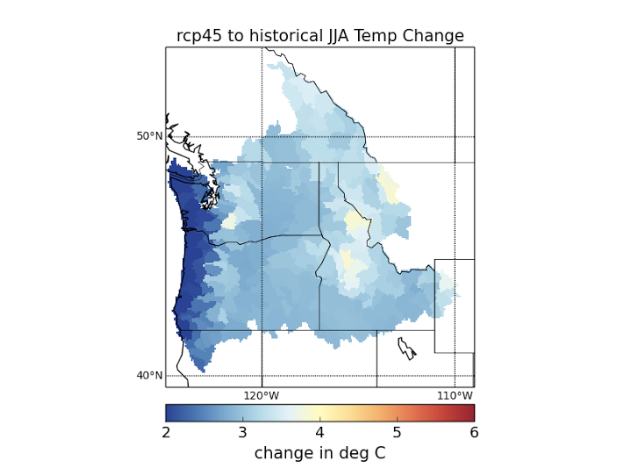
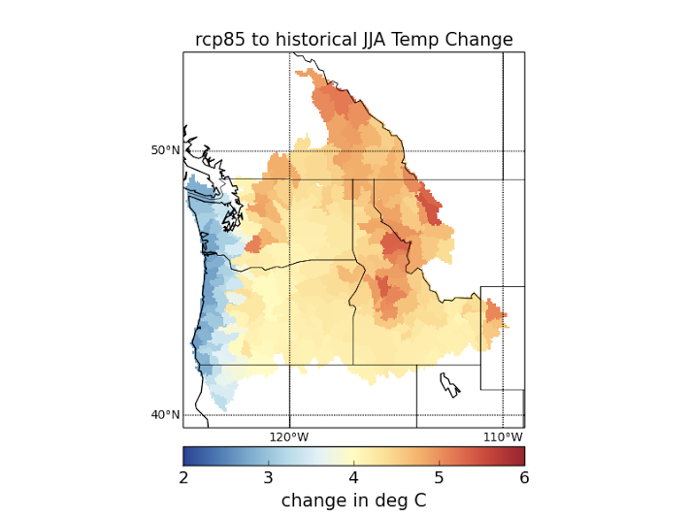
Notes:
When we look at temperature, we see a stronger increase in warming for summer than winter temperature. Here the leftmost column of plots is the historical winter and summer temperature magnitudes, the center represents the degree change in Celsius between the rcp4.5 future scenario and the historical period, and the rightmost column shows the degree change in Celsius between rcp8.5 and the historical period.
We see that that the winter temperature change for future scenarios goes from around 2-3 degrees for rcp4.5 to 3-4.5 for rcp8.5. For summer temperature, we see an increase of 2-4 degrees for rcp4.5 and then an increase of 3 to almost 6 degrees for rcp8.5.
So the temperature increases are significantly stronger for rcp8.5, and particularly so for summer temperature.

Slide 54
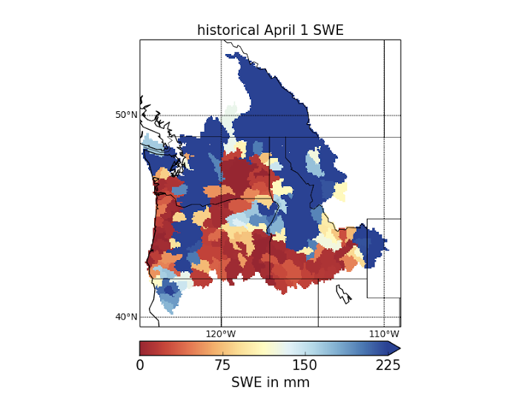
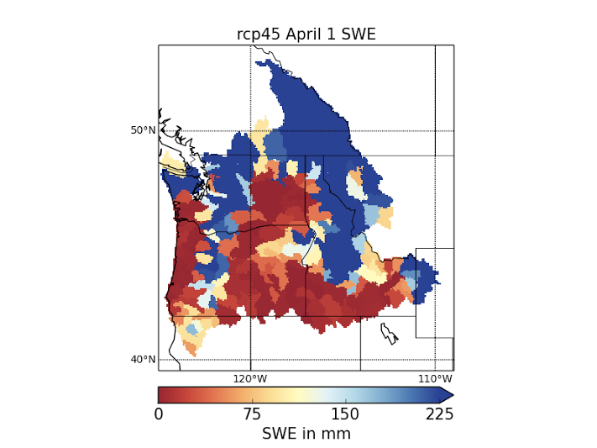

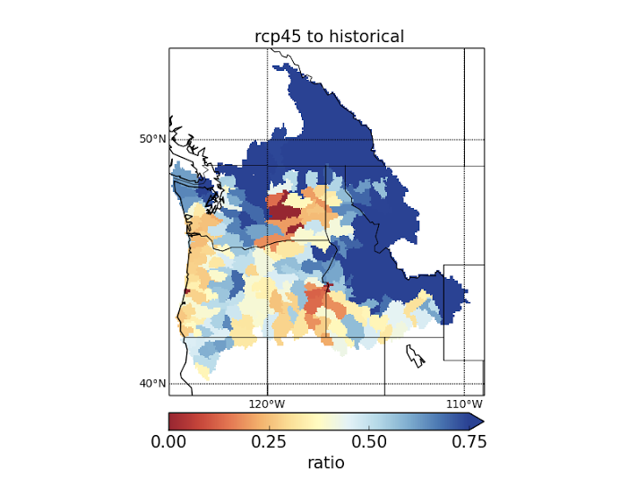

Future Changes in April 1 SWE
Notes:
With the classification results from the previous slide, it helps to look at historical versus future April 1 SWE magnitudes. The top row here is of the mean April 1 snow water equivalent for the historical 1950-2005 period, and the center and right plots in the top row are of rcp4.5 and 8.5 magnitudes for 2006 to 2100. We see a progression with more and more watersheds falling below 75 mm of SWE.
But in the bottom row, which represents the ratio of rcp4.5 mean April 1 SWE to historical SWE, and rcp8.5 mean April 1 SWE to historical, we see a stronger trend of decreasing SWE. Nowhere in the Pacific Northwest is there more than about 0.8% of historical levels, and in some parts of the region, there is 25-50% of historical levels. There is a particularly strong difference between the two scenarios along the WA/OR coast and in the Canadian portion of the Northern Rockies.

Slide 55
Summary of Results
Changes in timing primarily driven by warming
    summer warming stronger than winter warming, with significant differences between rcp4.5 and 8.5
    on average, floods will come earlier by 2 - 3 weeks
Changes in flood frequency primarily driven increases in intense precipitation
Next Steps: investigate duration of maximum flood event, expand analysis to regional level
Notes:
except at highest elevations and coldest basins, such as the upper elevations of the Cascades and parts of the Northern Rockies, wintertime p will shift toward rain resulting in thinner April 1 SWE and earlier occurrence of max annual flood
changes in flood frequency perhaps due to atmospheric river events, at least in the Cascades
investigating the duration of the flood event that produces the annual maximum flood
calculating extreme flow statistics
expand analysis from local, i.e. HUC-08 level, to regional level to account for inflows from upstream areas

Slide 56
How good are the models?

Slide 57


Slide 58
The appropriate test of downscaling’s relevance is not whether it alters paradigms of global climate science, but whether it improves understanding of climate change in the region where it is applied.

Slide 59
The November Surprise
JAN
FEB
MAR
APR
MAY
JUN
JUL
AUG
SEP
OCT
NOV
NOV
DEC
Courtesy Eric Salathé

Slide 60

Can RCMs reproduce the timing of precipitation maxima ?
Winter
Summer
from Mishra et al., GRL 2012

Slide 61
Summary
“Preponderance of evidence” for (some) increase in precipitation extremes
Not showing up in flood records (why not?)
Flooding in western U.S. is sensitive to warming (in observations) aside from changes in precipitation extremes
Climate signal (in flooding) is most likely being obscured by lots of natural variability
Opportunities (for enterprising graduate students) to better understand the interaction of climate (change) and flood risk across the U.S.

